Slide 1





Machine Learning
BEGINNER
EXPERT
→
1
Copyright © 2022 TalentLabs Limited
© zepanalytics.com

Slide 2



Agenda
1. 2. 3. 4. 5. 6. 7. 8. 9. 10. 11. 12. 13.
Introduction Use Cases Types of Learning Essential Libraries Feature Scaling Regression Algo’s Classification Algo’s Clustering Algo’s Association Rule Learning Ensemble Techniques Time Series Analysis Dimensionality Reduction -Feature Engineering Hyperparameter Optimization
2
Copyright © 2022 TalentLabs Limited
© zepanalytics.com

Slide 3




Introduction
3
Copyright © 2022 TalentLabs Limited
© zepanalytics.com

Slide 4


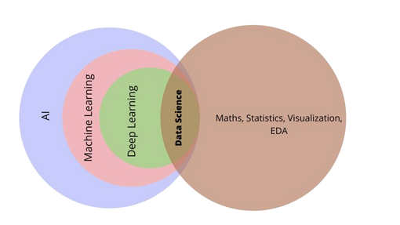
Introduction
● ●
ML is a subset of AI. Name derived from the concept that it deals with “construction & study of systems that can learn from data”
4
Copyright © 2022 TalentLabs Limited
© zepanalytics.com

Slide 5
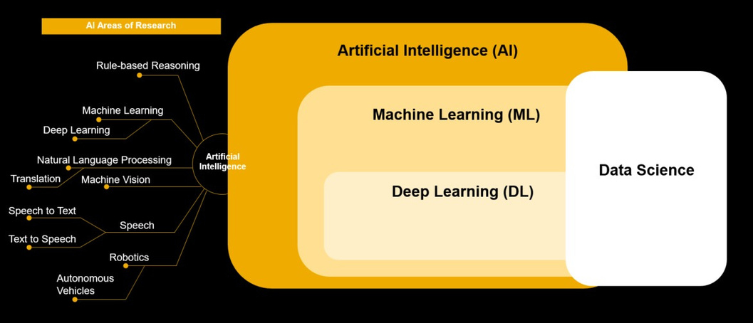
Biggest Confusion: AI vs ML vs DS vs DL
5
Copyright © 2022 TalentLabs Limited
© zepanalytics.com

Slide 6
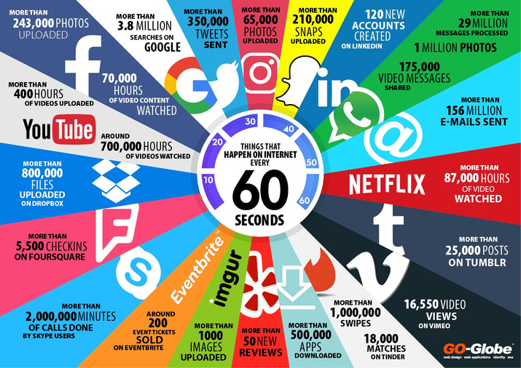
What is Machine Learning?
●
Machine learning is a type of artificial intelligence (AI) that provides computers with the ability to learn without being explicitly programmed. Machine learning focuses on the development of computer programs that can teach themselves to grow and change when exposed to new data.
●
6
Copyright © 2022 TalentLabs Limited
© zepanalytics.com

Slide 7

Why we need Machine Learning?
• • • • • •
Volumeofdata collected growing dayby day.
Data production is 5000% greater in 2021 than in 2010. Every day, 2.5 quintillion bytes of data are created Data is nearlydoubling in size every two years. Knowledge Discovery is needed to make sense and use of data. Machine Learning is a technique in which computers learn from data to
obtain insight and help in knowledge discovery
7
Copyright © 2022 TalentLabs Limited
© zepanalytics.com

Slide 8
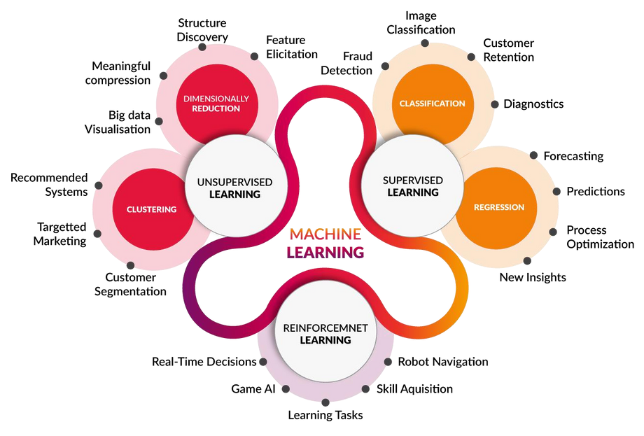
Types of Learning
8
Copyright © 2022 TalentLabs Limited
© zepanalytics.com

Slide 9
Use Cases
9
Copyright © 2022 TalentLabs Limited
© zepanalytics.com

Slide 10
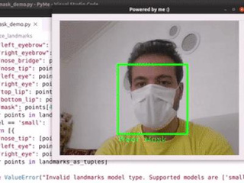





Applications of ML
10
Copyright © 2022 TalentLabs Limited
© zepanalytics.com

Slide 11






Health Care Use Cases
Better Imaging & Diagnostic
Disease Detection using Machine
Providing Personalized Treatment
Techniques
Learning
Preventing Medical Insurance
Drug Discovery & Research
Disease detection using Deep
Frauds
Learning
11
Copyright © 2022 TalentLabs Limited
© zepanalytics.com

Slide 12
Types of Learning
12
Copyright © 2022 TalentLabs Limited
© zepanalytics.com

Slide 13
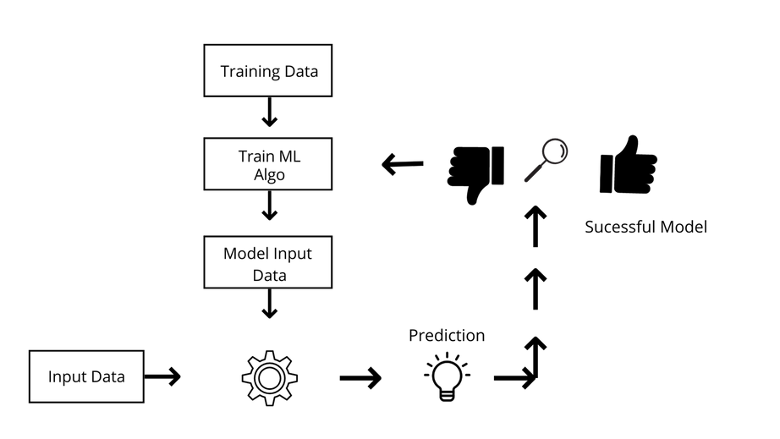
Types of Learning
1.
2. 3.
Supervised
Unsupervised Reinforcement
13
Copyright © 2022 TalentLabs Limited
© zepanalytics.com

Slide 14
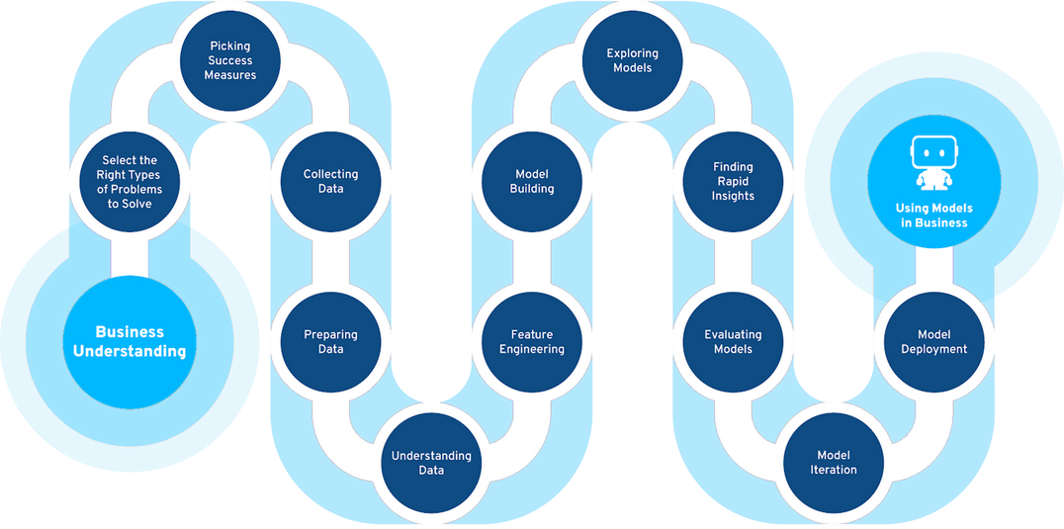
Learning Path
14
Copyright © 2022 TalentLabs Limited
© zepanalytics.com

Slide 15

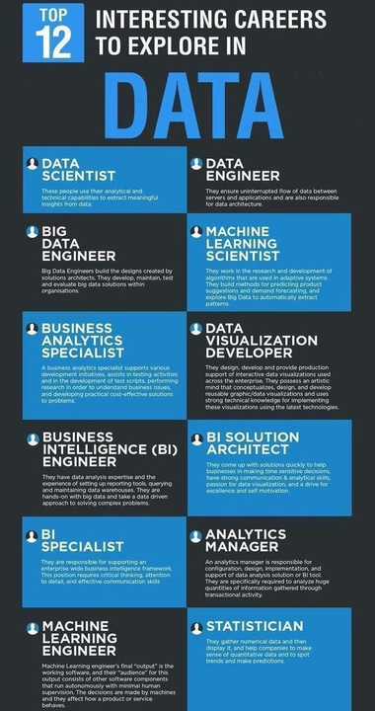
15
Copyright © 2022 TalentLabs Limited
© zepanalytics.com

Slide 16
Getting your dream job
1. Internet presence–Create profiles on Naukri, Monster, LinkedIn, Hirist, Glassdoor, Indeed, StackOverFlow etc.
2. Pushreusablecode/ apps to Github. Link it to your profile.
3.Write Blogs ,link it on your profiles.
4. Differentiator - Focus both on depth and breadth of Data Science.
5. Profiles should contain all the tech stacks keywords–e.g. Deep Learning, Machine Learning, NLP, Spark, Flask, Kafka, NoSQL, Python etc.
6. Headlines are important–Data Scientist, Machine Learning Engineer, etc
7. Prefix-Suffix with lead/ architect/ Head based on the years of experience and current role.
8.Project are a mustshowing good amount of relevant project experience solving industry level use cases.
9.Participate in online Hackathonsand Code challenges.
16
Copyright © 2022 TalentLabs Limited
© zepanalytics.com

Slide 17
Essential Libraries
17
Copyright © 2022 TalentLabs Limited
© zepanalytics.com

Slide 18

Essential Libraries
1. 2. 3. 4. 5. 6. 7. 8.
numpy: The matrix / numerical analysis layer at the bottom scipy: Scientific computing utilities (linalg, FFT, signal/image processing...) sklearn: Machine learning (our focus here) matplotlib: Plotting and visualization
opencv: Computer vision
pandas: Data analysis caffe, theano, minerva, tensorflow, keras: Deep neural networks spyder: The front end (Scientific Python Development Environment)
18
Copyright © 2022 TalentLabs Limited
© zepanalytics.com

Slide 19
Feature Scaling
19
Copyright © 2022 TalentLabs Limited
© zepanalytics.com

Slide 20

Train Test Split
The train_test_split() methodis used to split our data into train and test sets.
First, we need to divide our data into features (X) and labels (y). The dataframe gets divided into X_train,X_test , y_train andy_test.
X_train and y_train sets are used for training and fitting the model. The X_test and y_test sets are used for testing the model if it’s
predicting the right outputs/labels. we can explicitly test the size of the train and test sets. It is suggested to keep our train sets
larger than the test sets.
The train_test_split() method is used to split our data into train and test sets.
First, we need to divide our data into features (X) and labels (y). The dataframe gets divided into X_train,X_test , y_train andy_test.
X_train and y_train sets are used for training and fitting the model. The X_test and y_test sets are used for testing the model if it’s
predicting the right outputs/labels. we can explicitly test the size of the train and test sets. It is suggested to keep our train sets
larger than the test sets.
Trainset:Thetraining datasetisasetofdatathatwasutilizedtofitthemodel.Thedatasetonwhichthemodelistrained.Thisdata
is seen and learned by the model.
Test set:The test dataset is a subset of the training dataset that is utilized to give an accurate evaluation of a final model fit.
validation set:A validation dataset is a sample of data from your model’s training set that is used to estimate model performance
while tuning the model’s hyperparameters.
20
Copyright © 2022 TalentLabs Limited
© zepanalytics.com

Slide 21

Feature Scaling
Sepal Length, SepalWidth
What is the magnitude & Units.
→
Most ML’s use Euclidean distance, hence without feature scaling, most of the algo’s neglect the Units and focus on Magnitude,in
that case the Euclidean distance may vary significantly →Hence, o/p will be impacted.
1.
2.
3.
4.
Standardisation
Mean Normalization
Min-Max Scaling
Vector Scaling
21
Copyright © 2022 TalentLabs Limited
© zepanalytics.com

Slide 22
Regression Algorithms
22
Copyright © 2022 TalentLabs Limited
© zepanalytics.com

Slide 23
Regression
Regression analysis is a form of predictive modelling technique which investigates the relationship between a dependent (target) and independent variable (s) (predictor). This technique is used for forecasting, time series modelling and finding the causal effect relationship between the variables.
Let’s go through various regression algorithms:
1. Linear Regression
2. Lasso Regression 3. Polynomial Regression 4. Stepwise Regression 5. Ridge Regression
23
Copyright © 2022 TalentLabs Limited
© zepanalytics.com

Slide 25
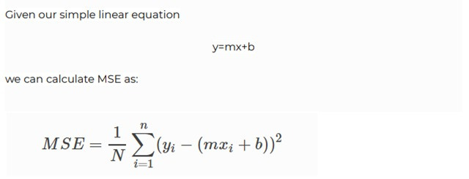
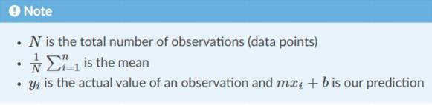
Linear Regression
Simple linear regression is a statistical method that enables users to summarise and study the relationships between two continuous (quantitative) variables. Linear regression is a linear model wherein a model that assumes a linear relationship between the input variables (x) and the single output variable (y). Here, y can be calculated from a linear combination of the input variables (x). When there is a single input variable (x), the method is called a simple linear regression. When there are multiple input variables, the procedure is referred to
as multiple linear regression.
24
Copyright © 2022 TalentLabs Limited
© zepanalytics.com

Slide 26
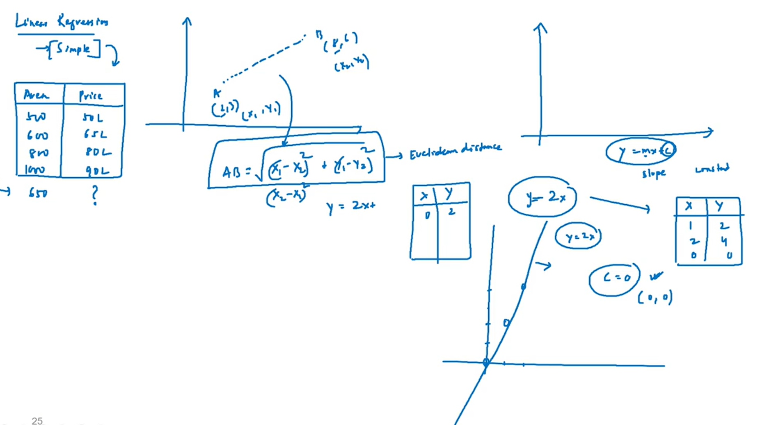

Slide 27
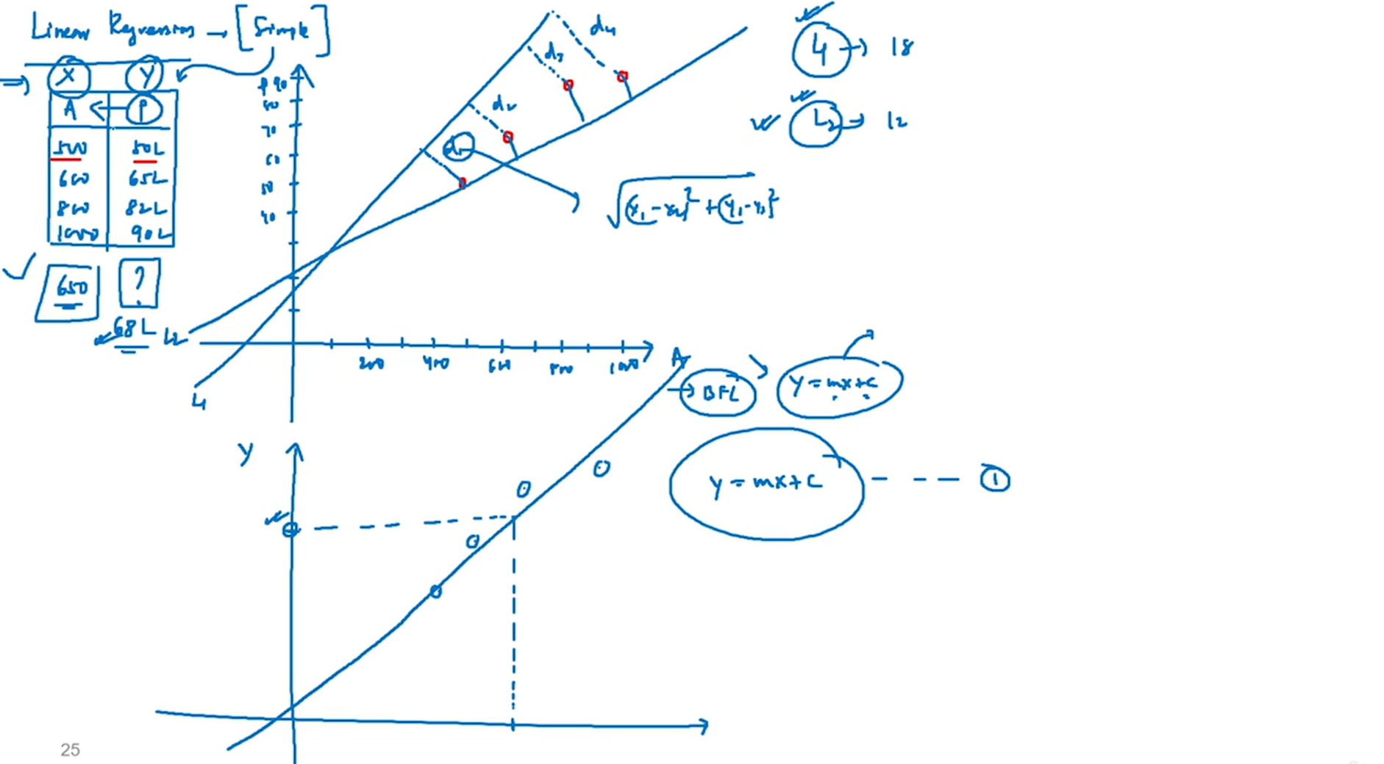

Slide 28
Simple Linear Regression
Simple Linear Regression is a statistical method used to model the relationship between:
One independent variable (X) — the predictor
One dependent variable (Y) — the outcome
It fits a straight line (called the regression line) through the data points to predict Y based on X.
Equation:
Y=a+bX
a = intercept (value of Y when X = 0)
b = slope (how much Y changes for a unit change in X)

Slide 29
Simple Linear Regression
Why It's Important
Prediction: Helps forecast outcomes (e.g., predicting sales based on advertising spend).
Understanding relationships: Reveals how one variable affects another.
Foundation for advanced models: It's the building block for multiple regression, logistic regression, and machine learning models.
Key Points to Remember
Linearity: Assumes a straight-line relationship between X and Y.
Residuals: Differences between actual and predicted values; used to assess model accuracy.
Least Squares Method: Minimizes the sum of squared residuals to find the best-fitting line.
Assumptions:
Linearity
Independence of errors
Constant variance (homoscedasticity)
Normal distribution of errors

Slide 30
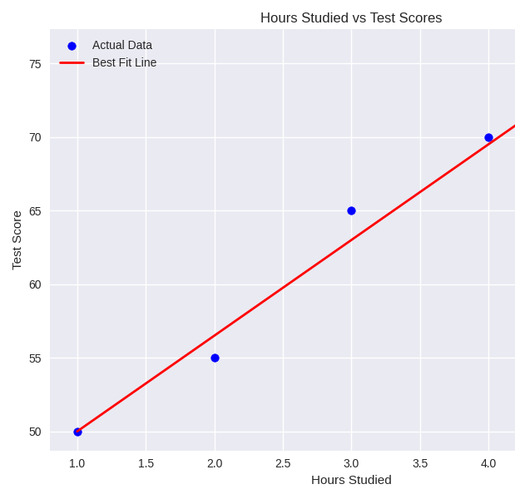
What Is the Best Fit Line?
The best fit line is the line that minimizes the total squared differences between the observed values and the predicted values. It’s the most accurate representation of the trend in the data.
Example: If you plot hours studied (X) vs. test scores (Y), the best fit line shows how scores typically increase with more study time
Here’s your visual of the best fit line for the relationship between hours studied and test scores:
Blue dots represent actual data points.
Red line is the best fit line from simple linear regression.
The upward slope shows a positive correlation — more study hours tend to lead to higher scores.

Slide 31
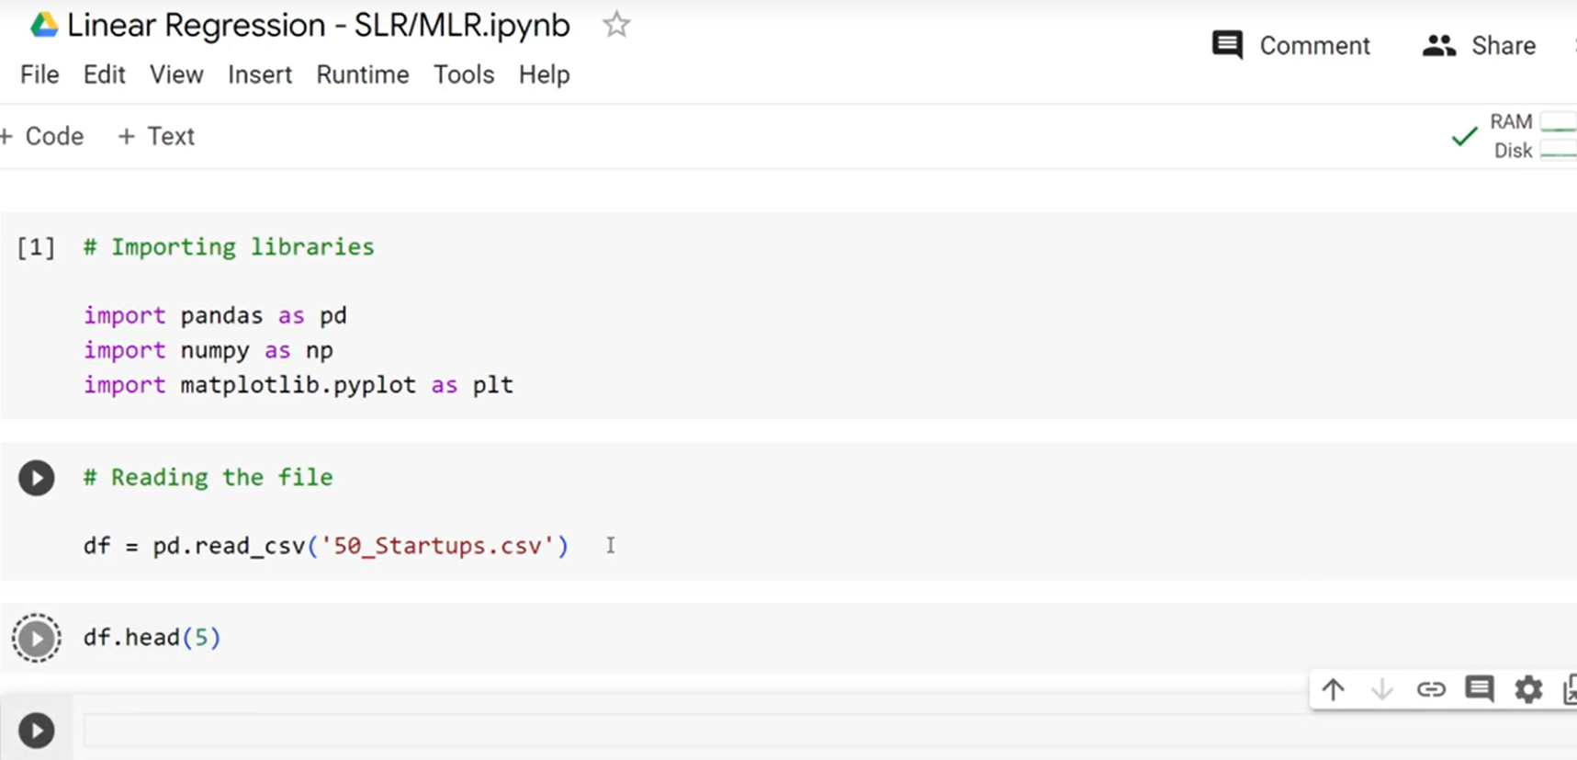
Linear Regresion

Slide 32
Linear Regression Code
Step 1: Import necessary libraries
import pandas as pd For data manipulation
import numpy as np For numerical operations
import matplotlib.pyplot as plt For data visualization
Step 2: Load the dataset
df = pd.read_csv('50_Startups.csv') Read CSV file into a DataFrame
print(df.head(5)) Display first 5 rows
print(df.info()) Show data types and null values
print(df.describe()) Summary statistics of numerical columns
Step 3: Divide the data into dependent vs independent / Select features and target variable
X = df.iloc[:, 0].values Select first column as independent variable
y = df.iloc[:, -1].values Select last column as dependent variable (target)

Slide 33
Linear Regression Code
Step 4: Split data into training and testing sets
from sklearn.model_selection import train_test_split
X_train, X_test, y_train, y_test = train_test_split(X, y, test_size=0.2) 80% train, 20% test
Step 5: Reshape data for model compatibility
X_train = X_train.reshape(-1, 1) Convert 1D array to 2D for training
X_test = X_test.reshape(-1, 1) Convert 1D array to 2D for testing
Step 6: Feature scaling (standardization)
from sklearn.preprocessing import StandardScaler
sc = StandardScaler() Create scaler object
X_train = sc.fit_transform(X_train) Fit and transform training data
X_test = sc.transform(X_test) Transform test data using same scaler

Slide 34
Linear Regression Code
Step 7: Train the Linear Regression model
from sklearn.linear_model import LinearRegression
regressor = LinearRegression() Create Linear Regression model
regressor.fit(X_train, y_train) Train model on scaled training data
Step 8: Make predictions on test data
y_pred = regressor.predict(X_test) Predict target values for test set
Step 9: Visualize actual vs predicted values
plt.plot(y_test, color='blue', label='Actual') Plot actual test values
plt.plot(y_pred, color='red', label='Predicted') Plot predicted values
plt.title('Actual vs Predicted')
plt.xlabel('Sample Index')
plt.ylabel('Target Value')
plt.legend()
plt.show()

Slide 35
Linear Regression Code
Step 10: Predict for a new input value
data = [[80000]] New input value (e.g., R&D Spend)
new_df = pd.DataFrame(data) Convert to DataFrame
new_df = sc.transform(new_df) Apply same scaling
new_prediction = regressor.predict(new_df) Predict using trained model
print("Predicted Output:", new_prediction[0]) Display prediction

Slide 36
Simple Linear Regression
The process begins by importing essential libraries that support data handling, numerical computation, and visualization. These tools allow us to load and explore the dataset efficiently. Once the dataset is loaded, we examine its structure and contents to understand the types of variables involved, check for missing values, and observe basic statistical properties such as mean, standard deviation, and range. This initial exploration helps us decide how to prepare the data for modeling.
Next, we separate the dataset into two parts: the independent variable (also called the feature or input) and the dependent variable (the target or output we want to predict). This distinction is crucial because the model learns patterns from the input to predict the output. To evaluate the model's performance fairly, we split the data into training and testing sets. The training set is used to teach the model, while the testing set helps us assess how well the model generalizes to unseen data.

Slide 37
Simple Linear Regression
Before training, we reshape the input data to ensure it fits the expected format of the machine learning algorithm. Then, we apply feature scaling — a technique that standardizes the input values so they have a consistent range and distribution. This step is especially important when the input values vary widely, as it helps the model converge faster and perform better.
With the data prepared, we create a linear regression model and train it using the scaled training data. The model learns the relationship between the input and output by fitting a straight line that minimizes prediction errors. Once trained, we use the model to make predictions on the test data and compare these predictions with the actual values. This comparison helps us understand how accurate the model is.
To visualize the results, we plot the actual test values alongside the predicted values. This graphical representation makes it easy to see how closely the model's predictions match reality. Finally, we demonstrate how to use the trained model to predict the output for a new input value. This involves applying the same scaling transformation to the new data and then using the model to generate a prediction. This last step shows how the model can be used in real-world scenarios to make informed decisions based on new inputs.

Slide 38
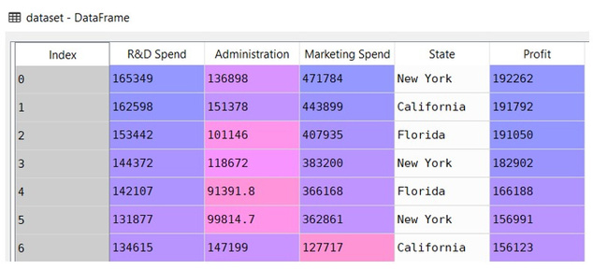
Multiple Linear Regression
Simple Linear Regression →y = bo + b1*x1 Multiple Linear Regression →y = bo + b1*x1
b2*x2 + …. + bn*xn
Where, y →Dependent variable
x1, x2, ….xn →Independent variables
The difference between simple linear regression and multiple linear regression, multiple linear regression has (>1) independent variables, whereas simple linear regression has only 1 independent variable.
+
25
Copyright © 2022 TalentLabs Limited
© zepanalytics.com

Slide 39
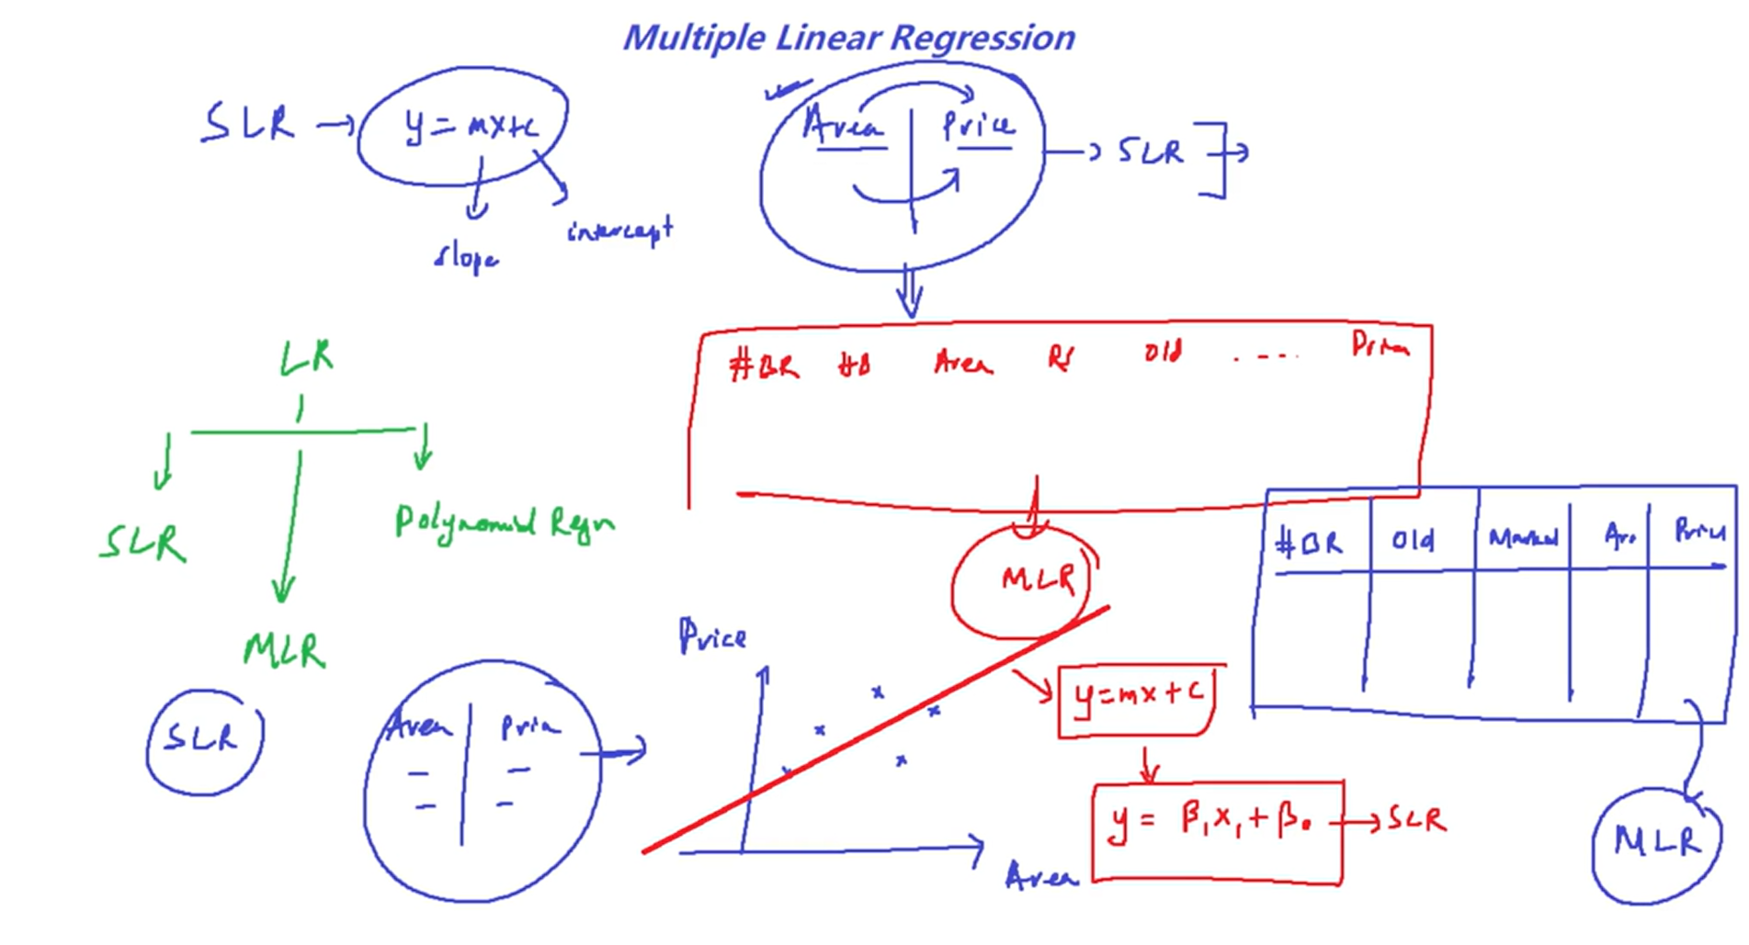

Slide 40
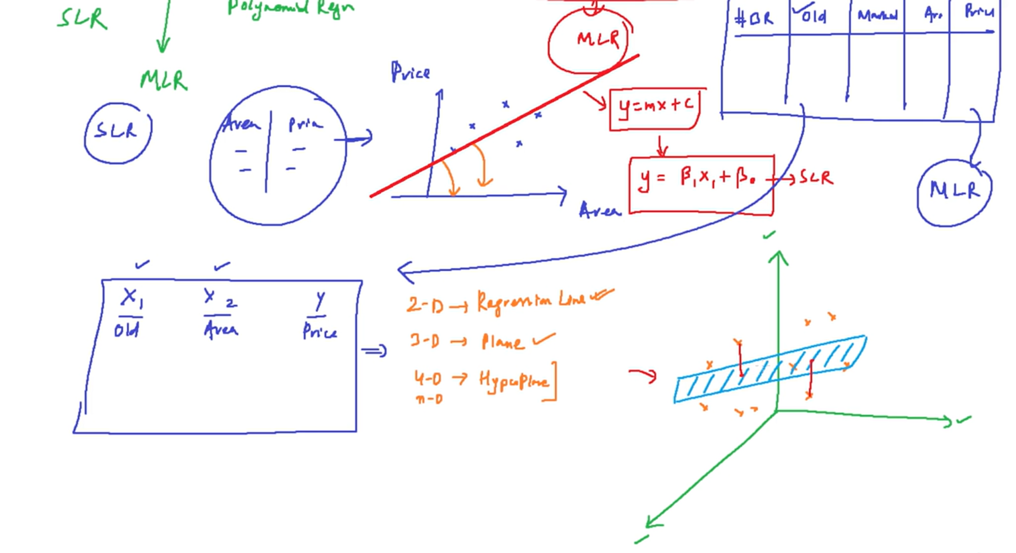

Slide 41
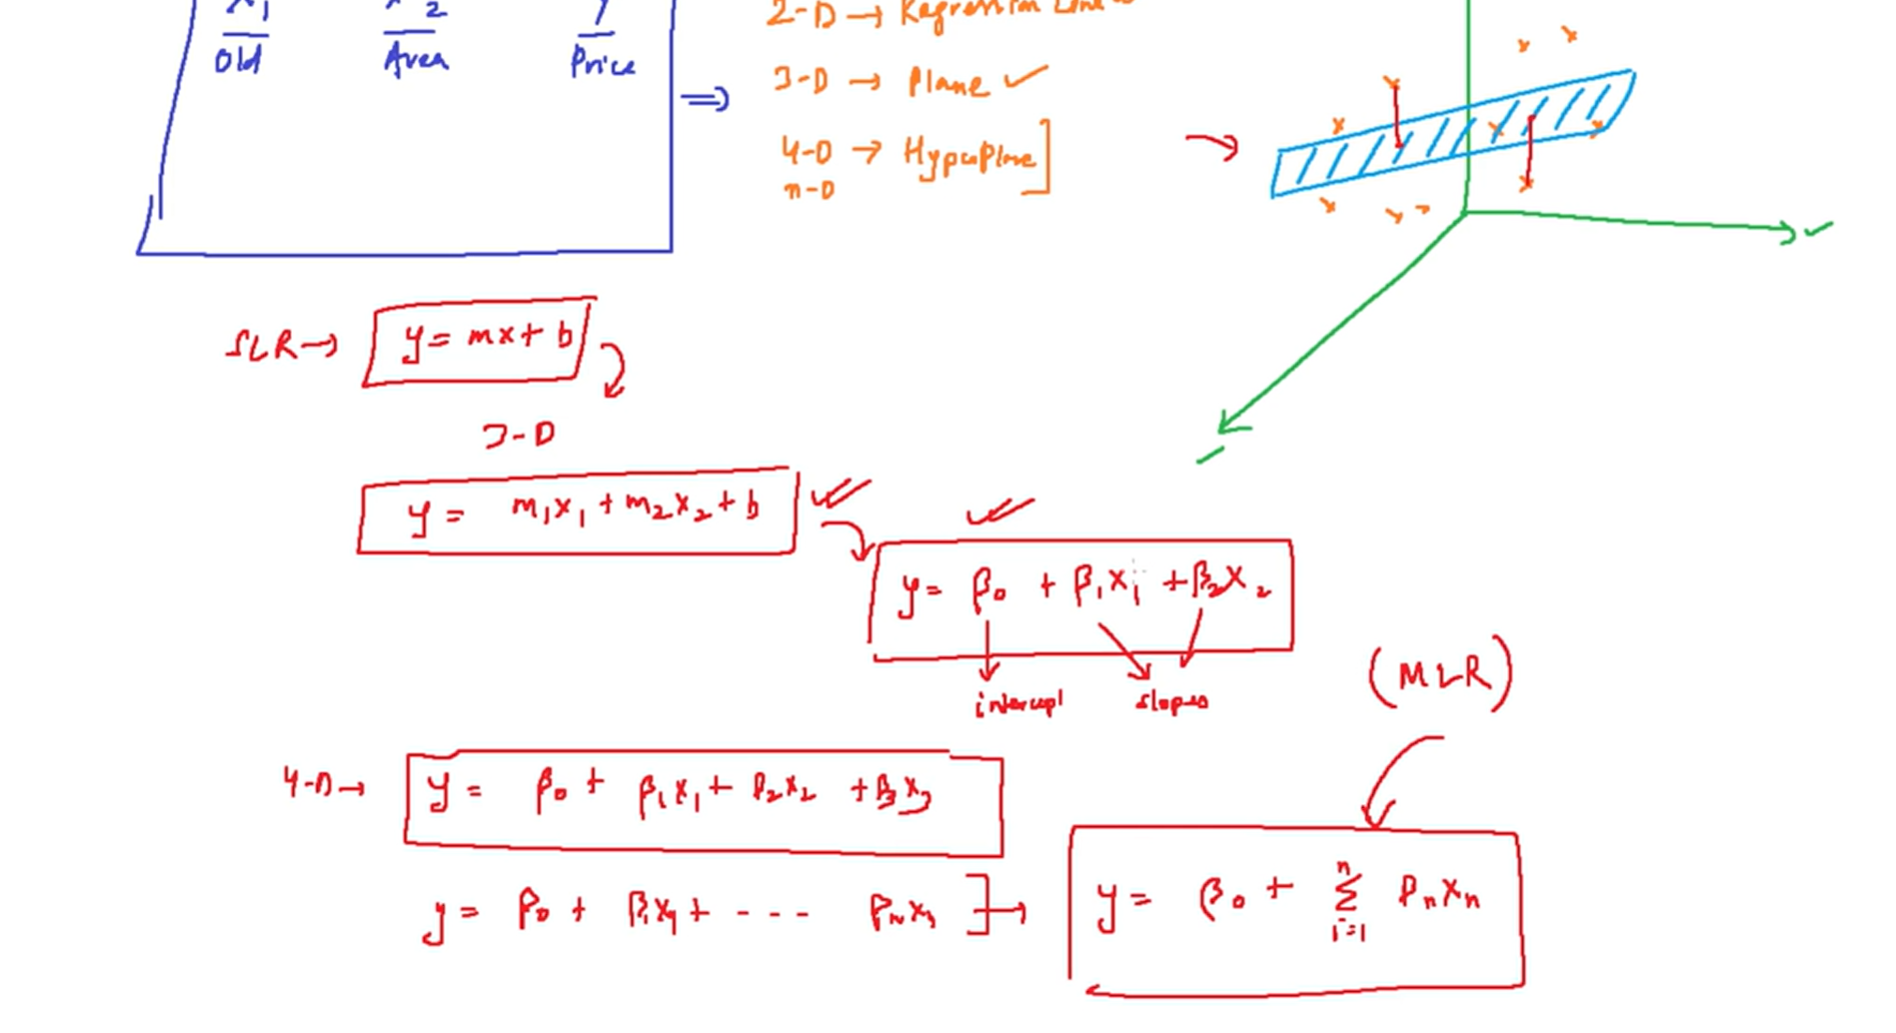

Slide 42
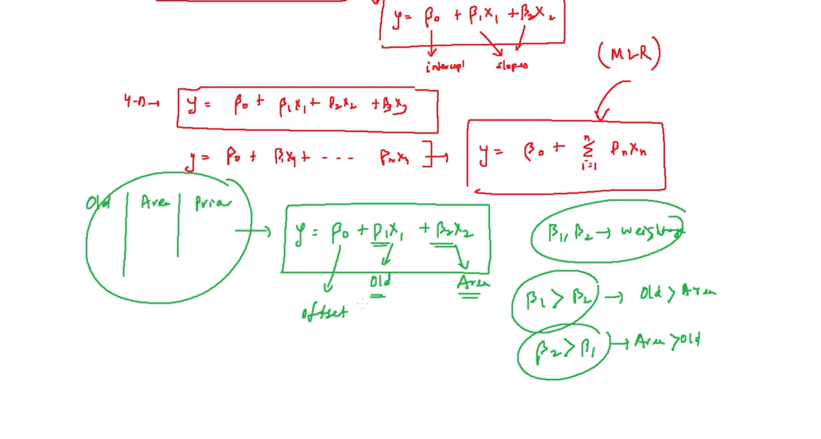

Slide 43
What Is Multiple Linear Regression?
Multiple Linear Regression predicts the value of a dependent variable (Y) based on several independent variables (X₁, X₂, X₃, …).
Equation:
Y=a+b1X1+b2X2+b3X3+⋯+bnXn
Y = dependent variable
X₁, X₂, … Xₙ = independent variables
a = intercept
b₁, b₂, … bₙ = coefficients (effect of each X on Y)
Why It’s Useful:-
Captures complex relationships between variables.
Controls for confounding factors.
Improves prediction accuracy.
Essential for real-world modeling (e.g., predicting house prices using size, location, number of rooms, etc.).

Slide 44
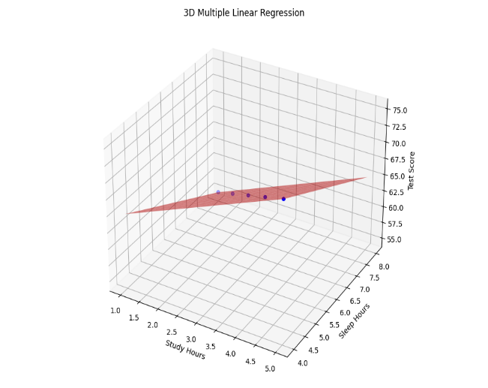
Key Concepts
Multicollinearity: When predictors are highly correlated, it can distort the model.
Adjusted R²: Better than R² for evaluating models with multiple predictors.
Feature selection: Choosing the most relevant variables improves performance.
Assumptions:
1. Linearity , 2. Independence of errors,3. Homoscedasticity (constant variance),4. Normality of residuals 5. No multicollinearity
Here’s your 3D visualization of Multiple Linear Regression using two predictors:
Blue dots represent actual data points: combinations of study hours, sleep hours, and test scores.
Red surface is the regression plane — the best fit surface that models how both study and sleep hours influence test scores.
This plot shows how the test score increases with more study hours and decreases with less sleep, capturing the combined effect of both variables.

Slide 45
Code

Slide 46
Code

Slide 47
Code

Slide 48
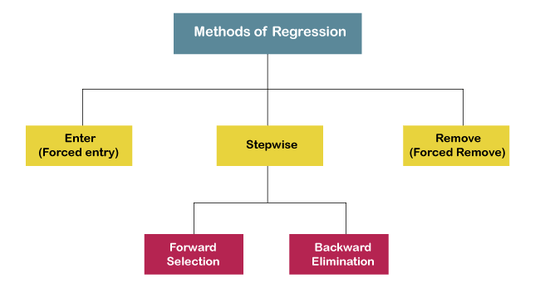
Multiple Linear Regression
5 methods of building models:
1. All-in
2. Backward Elimination →Stepwise
3. Forward Selection →Stepwise
4. Bidirectional Elimination →Stepwise
5. Score Comparison
26
Copyright © 2022 TalentLabs Limited
© zepanalytics.com

Slide 49
Multiple Linear Regression
Backward Elimination
→
Stepwise
Forward Pass
→
Stepwise
1.
2.
3.
4.
5.
1.
2.
3.
Select a significance level to stay in the model (Let say 0.05) Fit the full model with all possible predictors Consider the predictor with highest p-value and if p-value > SL, go to step 4, else FIN Remove that predictor Fit the model without this variable
Select a significance level to stay in the model (Let say 0.05) Fit all simple regression models. Select one with lowest p-value Keep the variable & fit all the possible models with one extra predictor added to one you already have. Consider the predictor with lowest p-value. If p>SL, go to Step 3 else go to FIN
4.
27
Copyright © 2022 TalentLabs Limited
© zepanalytics.com

Slide 50
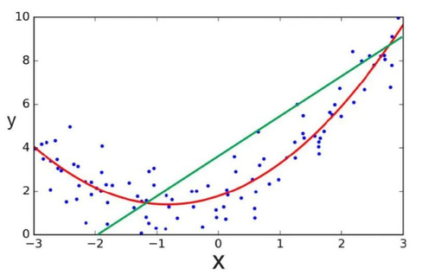
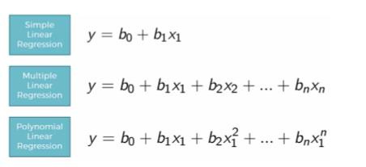
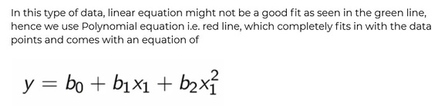
Polynomial Regression
The equation of
Polynomial
Regression
is:
28
Copyright © 2022 TalentLabs Limited
© zepanalytics.com

Slide 51
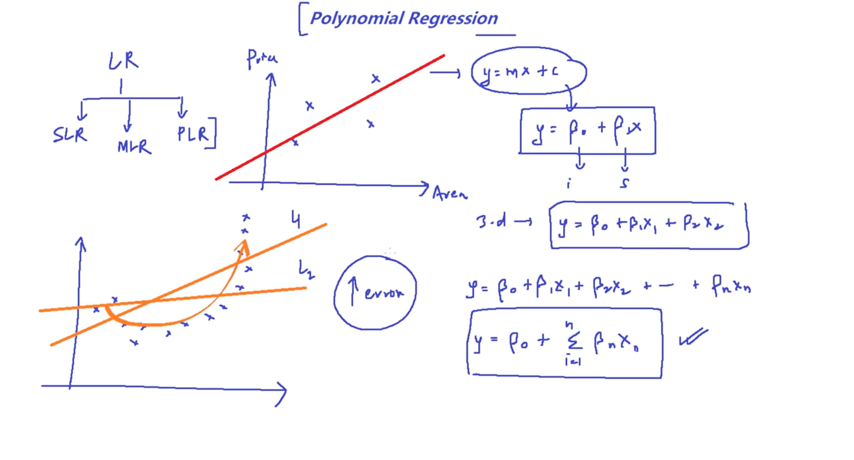

Slide 52
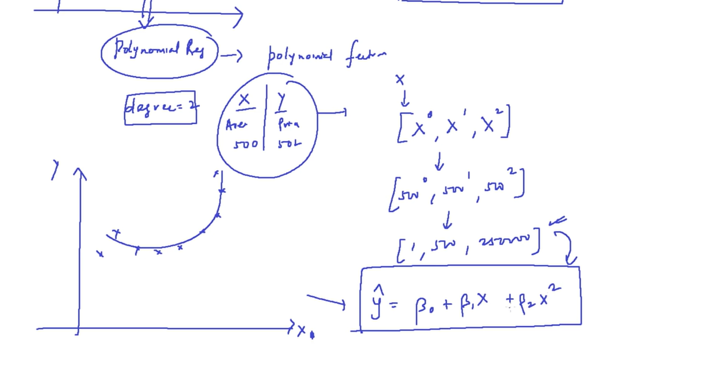

Slide 53
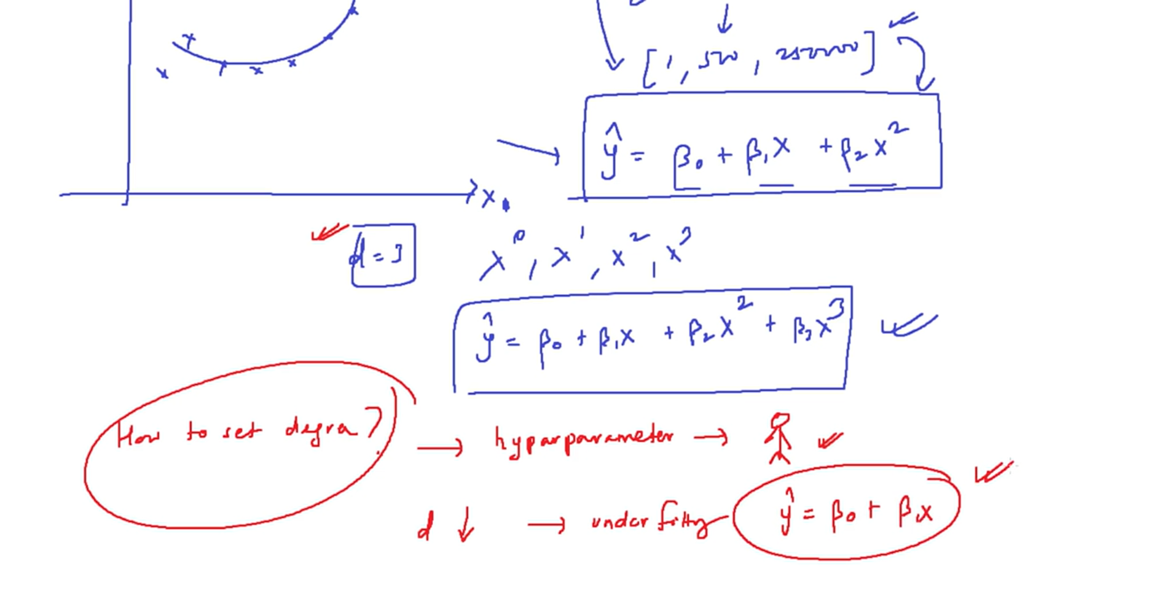

Slide 54
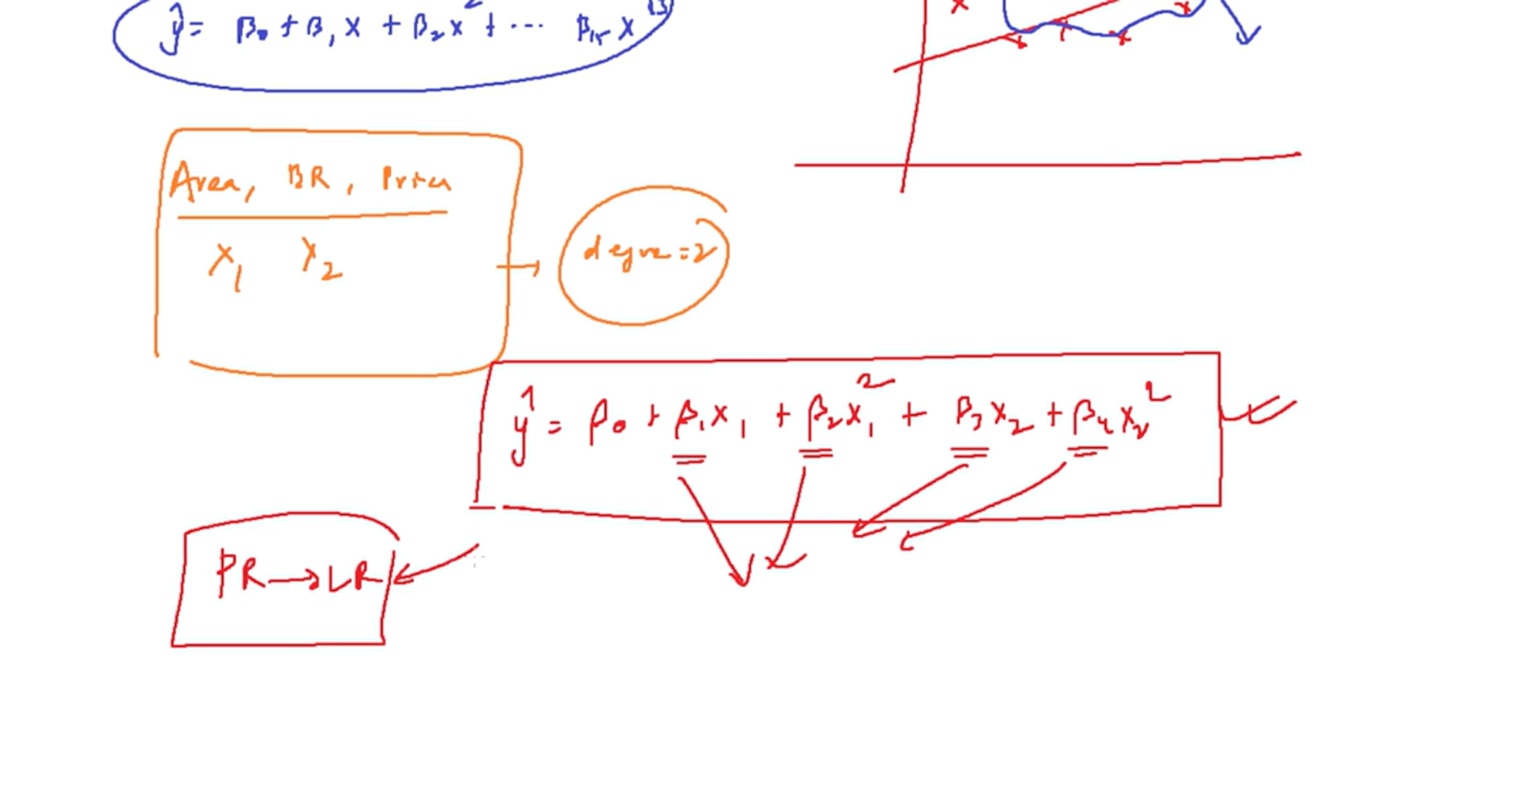

Slide 55
Code

Slide 57
What Is the Bias-Variance Tradeoff?
The bias-variance tradeoff is a fundamental concept in machine learning that helps explain why models perform well—or poorly—on unseen data. Here's a breakdown of what it means and why it matters:
In supervised learning, prediction error can be decomposed into three parts:
Bias: Error due to overly simplistic assumptions in the model.
Variance: Error due to sensitivity to small fluctuations in the training data.
Irreducible Error: Noise inherent in the data that no model can eliminate. The tradeoff is about balancing bias and variance to minimize total error.

Slide 58
What Is the Bias-Variance Tradeoff?
Bias: Underfitting
High bias means the model is too simple (e.g., linear regression on nonlinear data).
It fails to capture the underlying patterns.
Leads to underfitting: poor performance on both training and test data.
Example: Predicting housing prices using only square footage, ignoring location, number of rooms, etc.
Variance: Overfitting
High variance means the model is too complex (e.g., high-degree polynomial).
It captures noise in the training data as if it were signal.
Leads to overfitting: excellent performance on training data but poor generalization to new data.
Example: A decision tree that perfectly classifies training data but fails on test data.

Slide 59
What Is the Bias-Variance Tradeoff?
The Tradeoff
Low bias + high variance: Overfitting
High bias + low variance: Underfitting
Optimal model: Balances bias and variance to generalize well
This balance is often visualized using Mean Squared Error (MSE):
How to Manage the Tradeoff:
Model selection: Choose algorithms appropriate for the complexity of your data.
Regularization: Techniques like L1/L2 penalties reduce variance.
Cross-validation: Helps estimate generalization error.
Ensemble methods: Combine models to reduce variance (e.g., Random Forests).

Slide 60
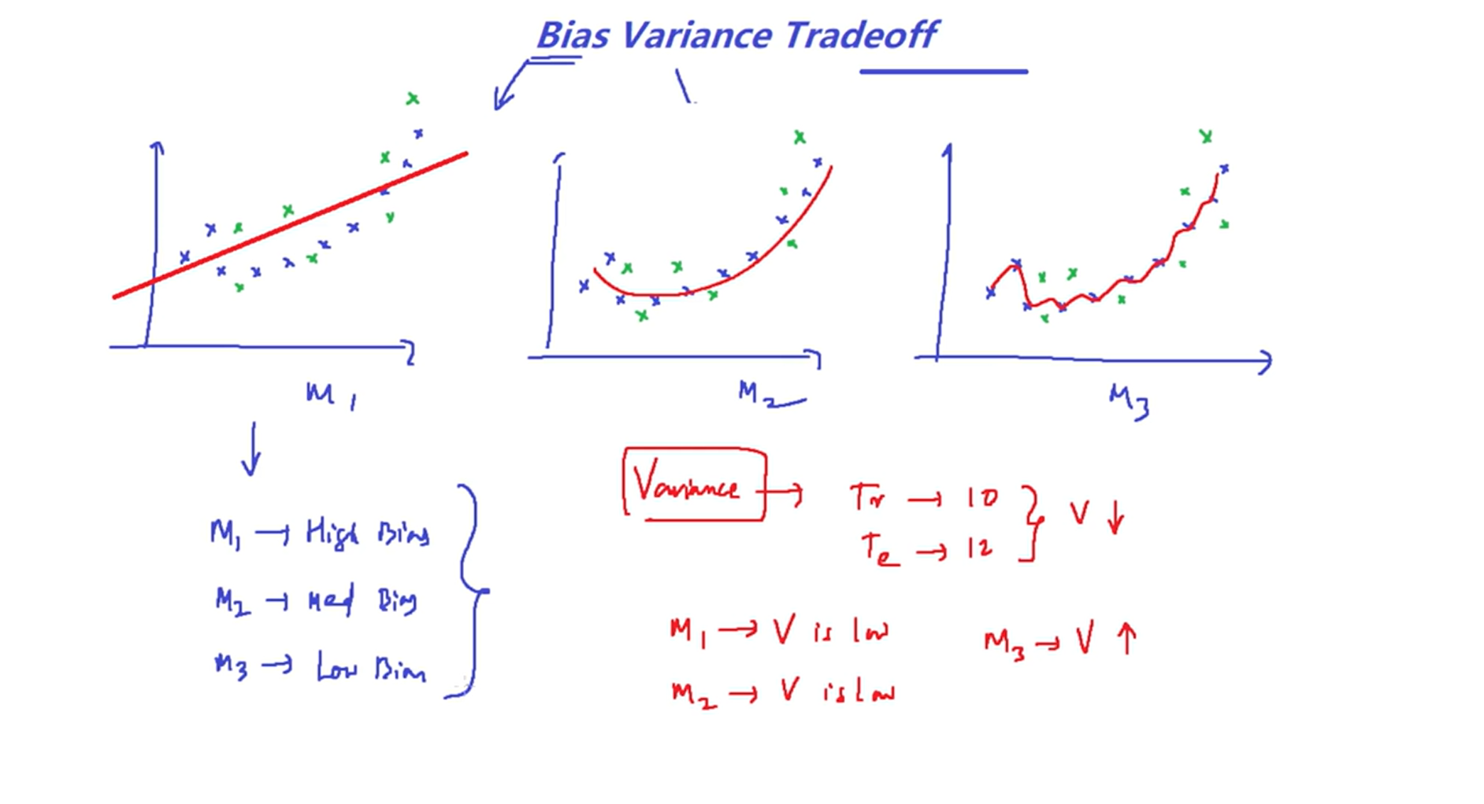

Slide 61
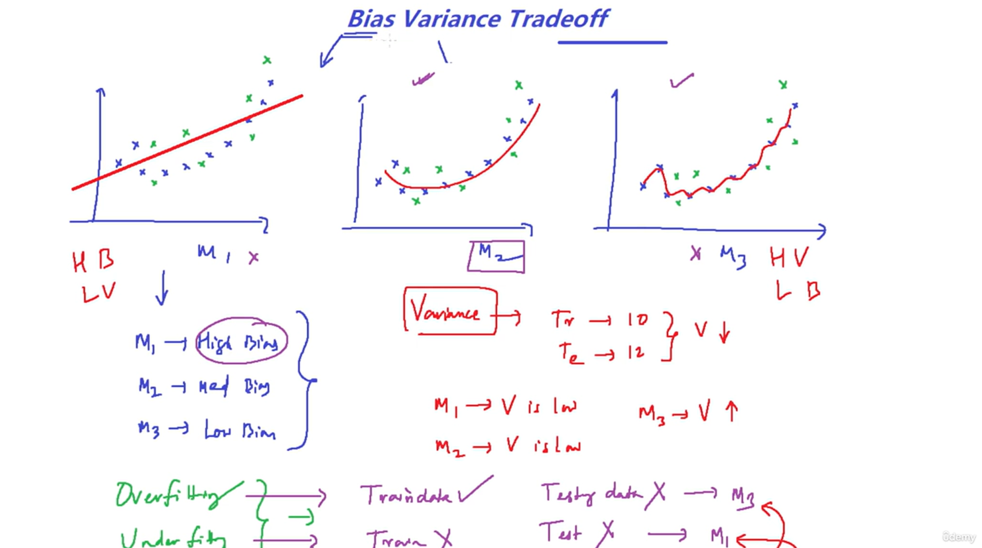

Slide 62
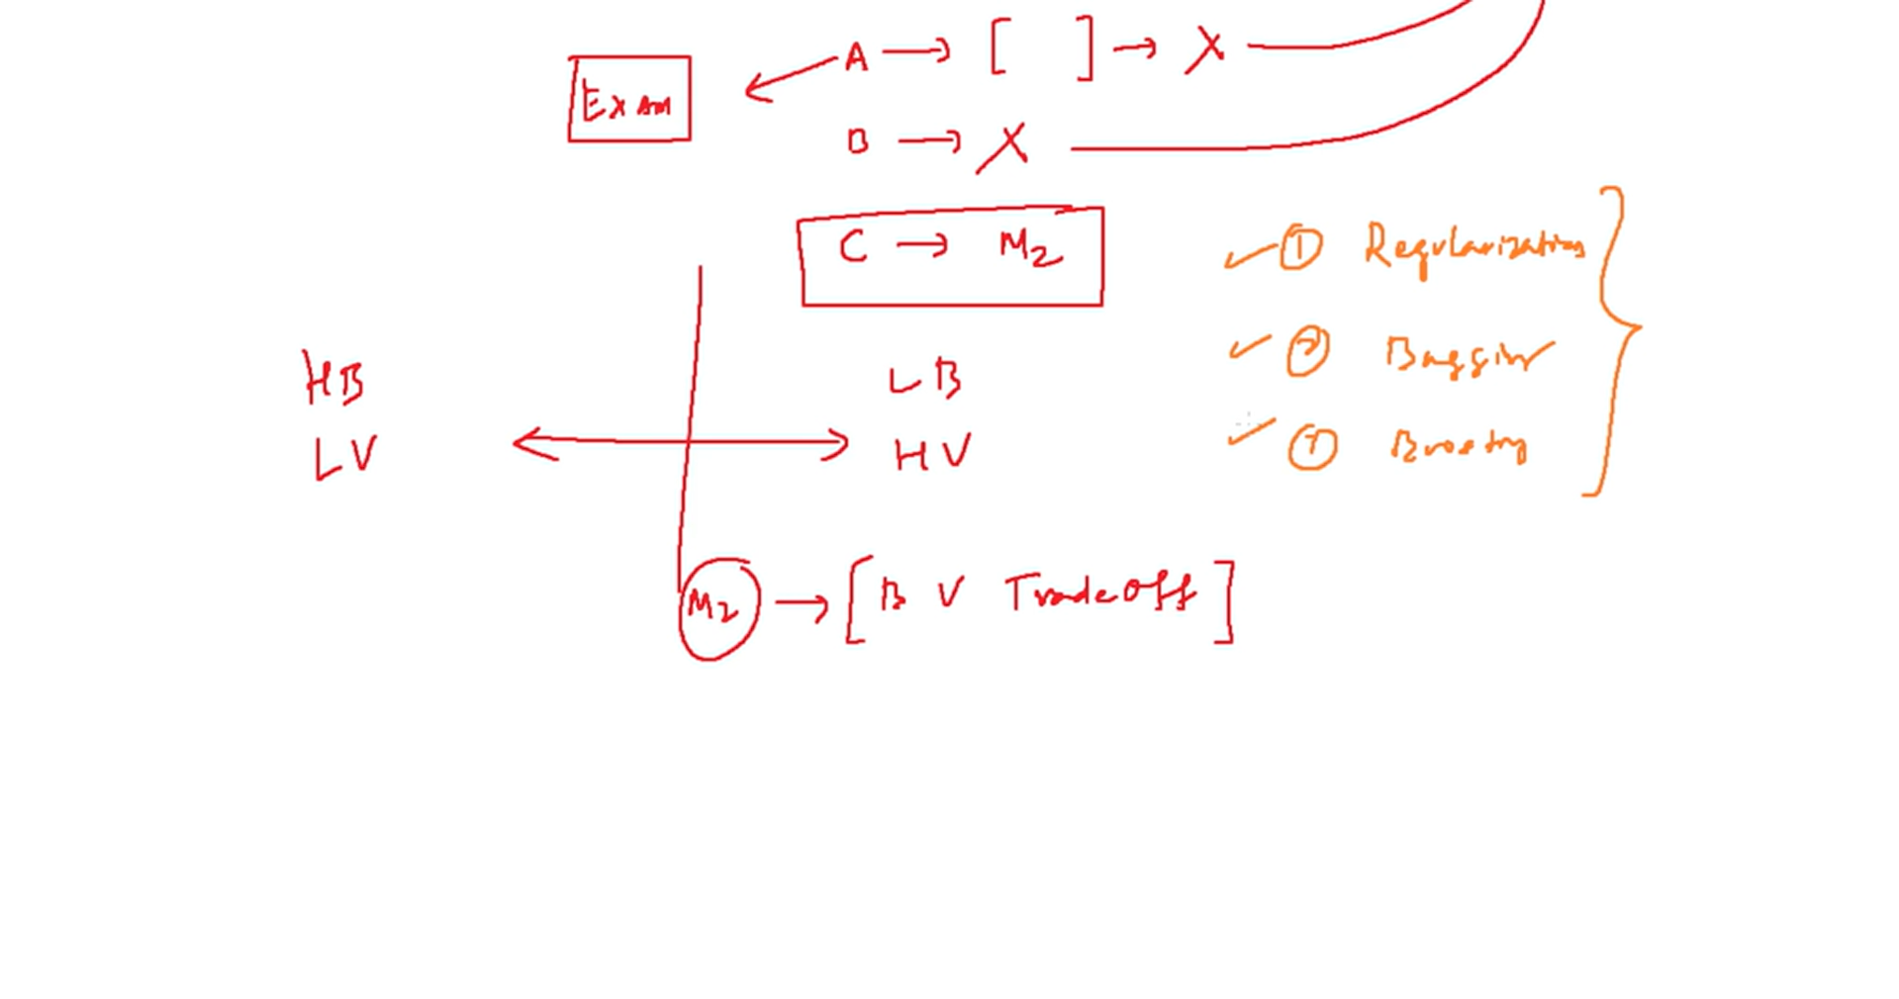

Slide 63

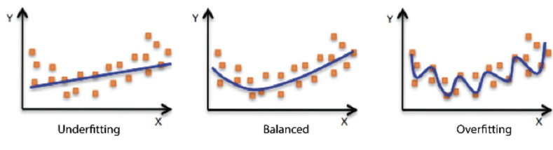

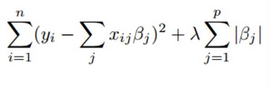
LASSO and RIDGE Regression
•
Regularisation helps avoid overfitting data at the cost of some added error.
LASSO (Least Absolute Shrinkage Selector
Operator) and Ridge regression are
regularisation techniques used for improving
the robustness of the model.
•
LASSO or L1 penalty can be used for
dimensionality reduction also
•
29
Copyright © 2022 TalentLabs Limited
© zepanalytics.com

Slide 64

LASSO and RIDGE Regression
•
Regularisation helps avoid overfitting data at the cost of some added error.
LASSO (Least Absolute Shrinkage
Selector Operator) and Ridge
regression are regularisation
techniques used for improving the
robustness of the model.
•
LASSO or L1 penalty can be used for
dimensionality reduction also
•
30
Copyright © 2022 TalentLabs Limited
© zepanalytics.com

Slide 65

Regression Error Metrics
MAE, MSE, RMSE, MAPE etc.
•
•
•
•
MSE (Mean Squared Error)
RMSE (Root Mean Squared Error)
MAE (Mean Absolute Error)
MAPE (Mean Absolute Percentage Error)
31
Copyright © 2022 TalentLabs Limited
© zepanalytics.com

Slide 66
Regression Metrics
Regression is a type of statistical and machine learning technique used to model the relationship between a dependent variable (target) and one or more independent variables (features). It helps predict continuous outcomes, like prices, temperatures, or scores
For example: Predicting house prices based on size, location, and number of rooms.
Common Regression Metrics
MAE (Mean Absolute Error): Average of absolute differences between predicted and actual values. Shows typical prediction error size.
MSE (Mean Squared Error): Average of squared differences; penalizes larger errors more than MAE.
RMSE (Root Mean Squared Error): Square root of MSE; gives error in the same units as the target variable.
R² (R-squared): Measures how well the model explains the variance in the data. Closer to 1 means better fit.

Slide 67
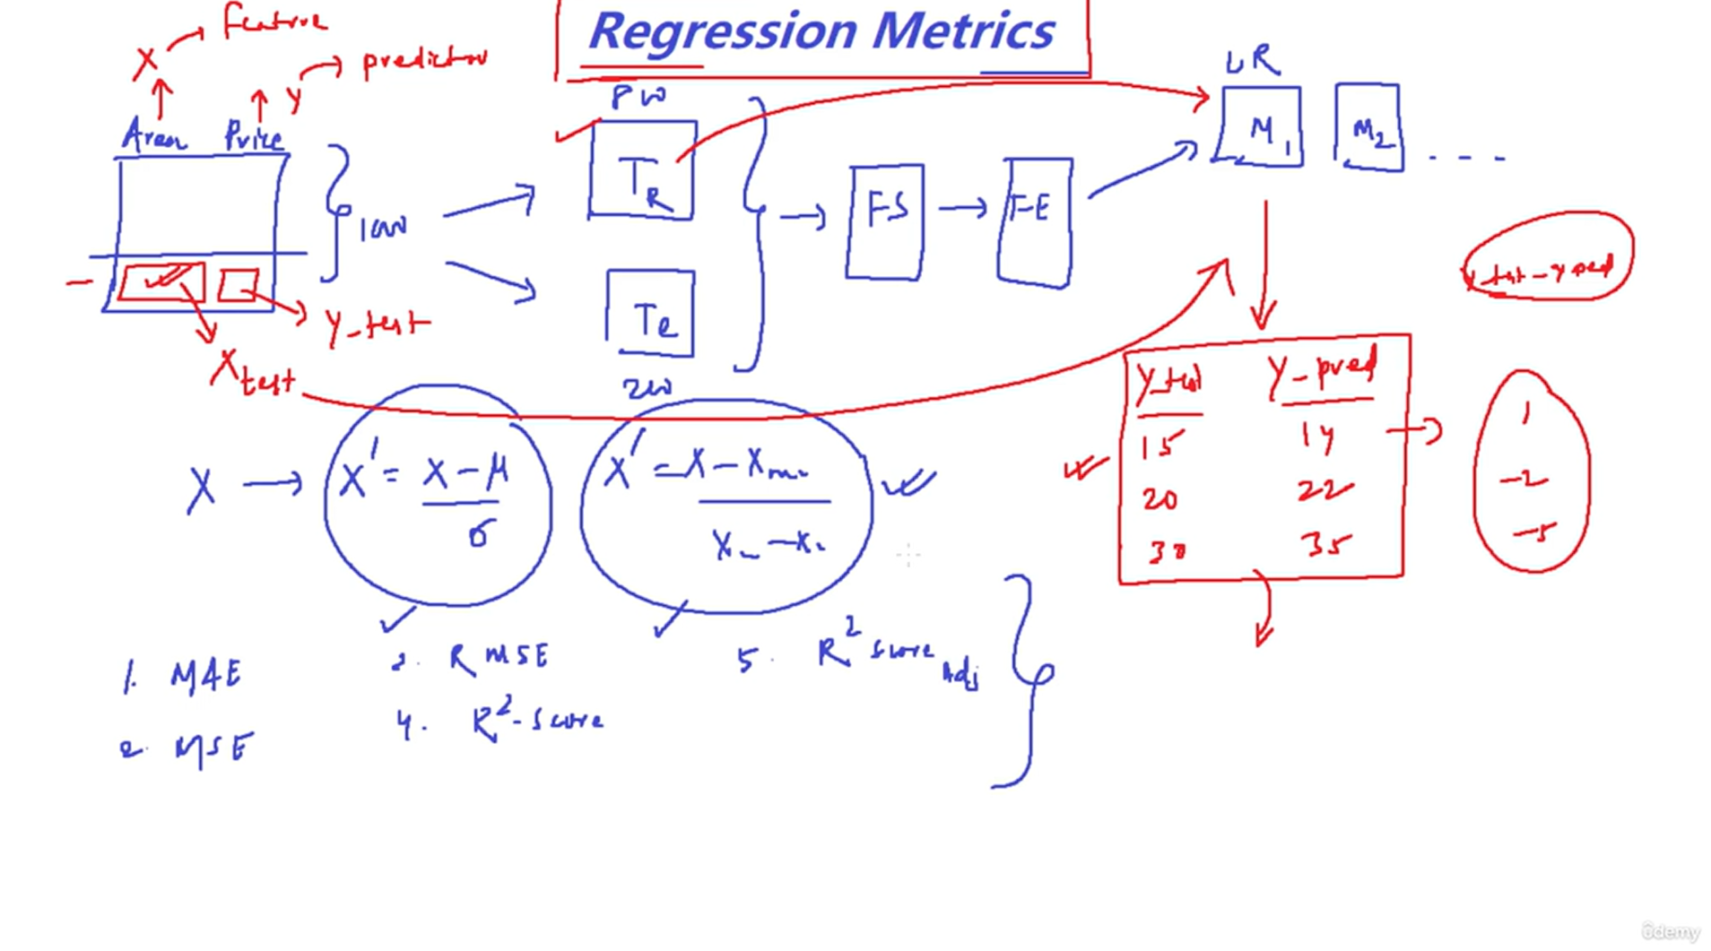

Slide 68
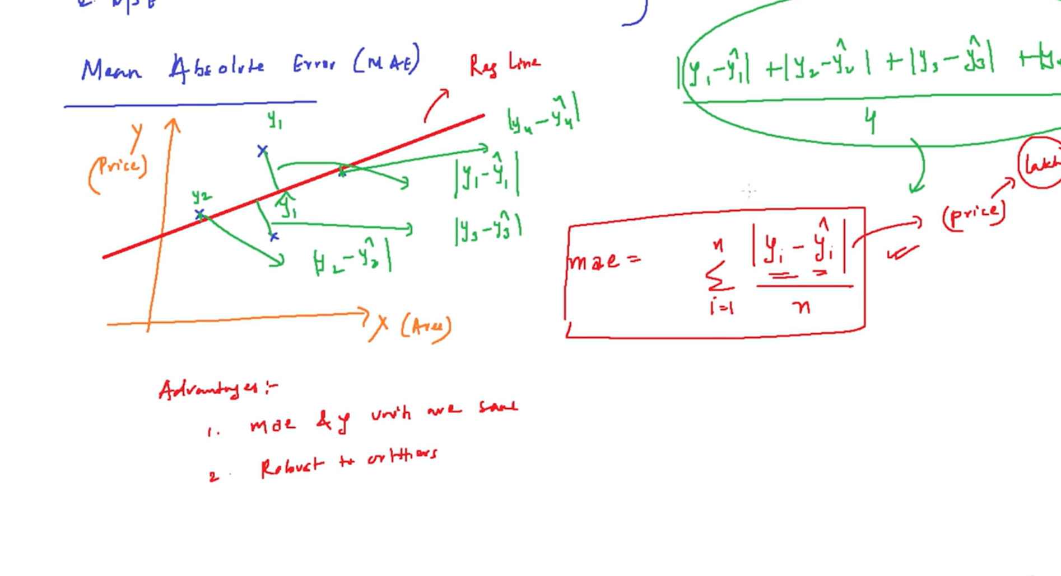

Slide 69
Mean Absolute Error :
Advantages of MAE
Easy to interpret: MAE gives a clear average error in the same units as the target variable.
Robust to outliers: Compared to MSE, MAE doesn’t exaggerate the impact of large errors.
Disadvantages of MAE
Not differentiable at zero: Makes it harder to use in some optimization algorithms.
Equal weight to all errors: Doesn’t penalize large mistakes more than small ones, which might be undesirable in some cases.

Slide 70
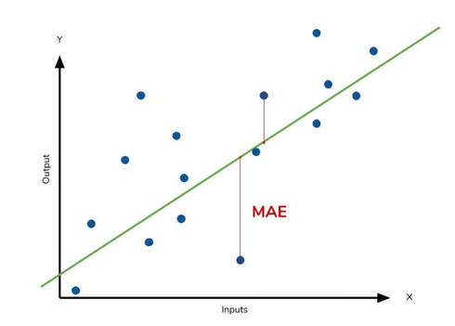

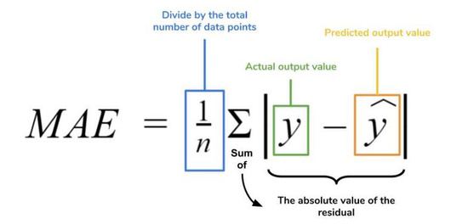
Mean Absolute Error (MAE)
MAE: We just look at the absolute difference between data and model’s predictions
Lower MAE →Better model
32
Copyright © 2022 TalentLabs Limited
© zepanalytics.com

Slide 71
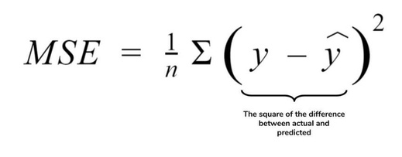
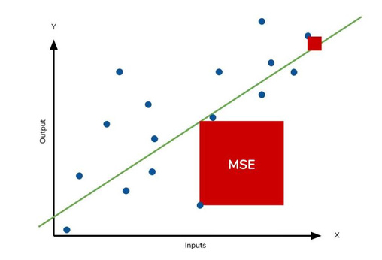
Mean Squared Error (MSE)
MSE is going to be a huge number because of squaring, hence, we can’t compare it with MAE. This ultimately means that outliers in our data will contribute to much higher total error in the MSE than they would the MAE. Similarly, our model will be penalized more for making predictions that differ greatly from the corresponding actual value. This is to say that large differences between actual and predicted are punished more in MSE than in MAE.
33
Copyright © 2022 TalentLabs Limited
© zepanalytics.com

Slide 72

Root Mean Squared Error (RMSE)
RMSE = Square root(MSE)
As the name suggests, it is the square root of the MSE.
Because the MSE is squared, its units do not match
that of the original output. Researchers will often use
RMSE to convert the error metric back into similar units,
making interpretation easier. Since the MSE and RMSE
both square the residual, they are similarly affected by
outliers.
34
Copyright © 2022 TalentLabs Limited
© zepanalytics.com

Slide 73
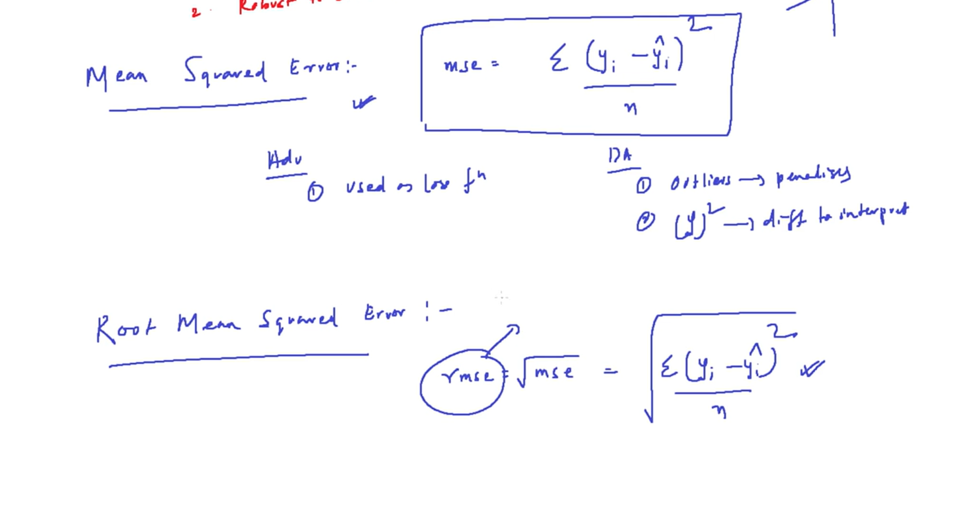

Slide 74
Advantage and Disadvantage of Regression Metrics
Metric | Advantages | Disadvantages
MAE (Mean Absolute Error) | Easy to interpret Less sensitive to outliers | Treats all errors equally Not differentiable at zero
MSE (Mean Squared Error) | Penalizes large errors more Smooth for optimization | Sensitive to outliers Harder to interpret (squared units)
RMSE (Root Mean Squared Error) | Same units as target Highlights large errors | Still sensitive to outliers Can be misleading with mixed error sizes

Slide 75
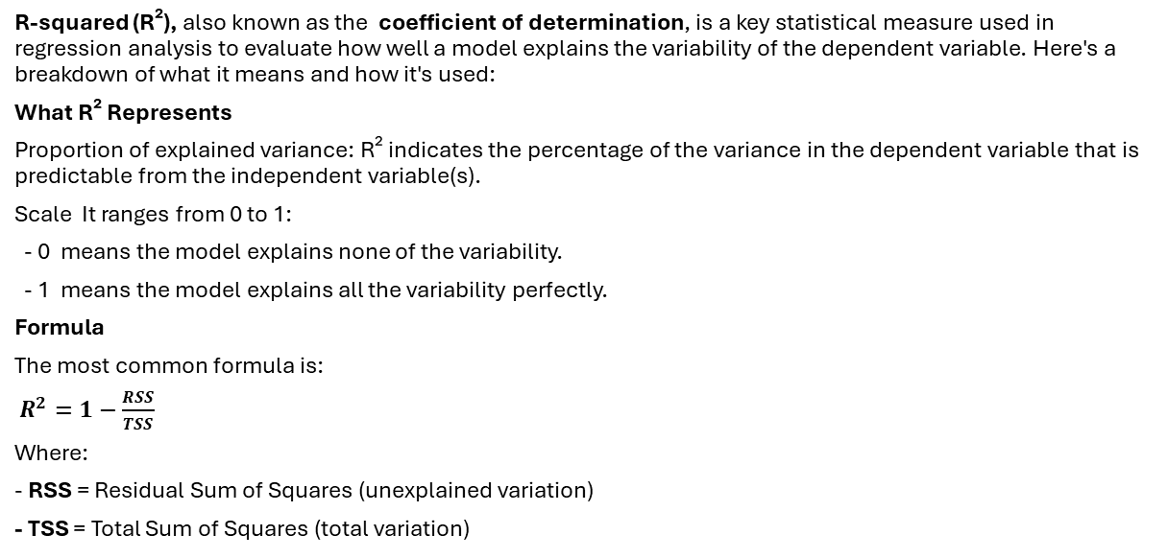
R-squared (R²)
R-squared (R²), also known as the coefficient of determination, is a key statistical measure used in regression analysis to evaluate how well a model explains the variability of the dependent variable. Here's a breakdown of what it means and how it's used:
What R² Represents
Proportion of explained variance: R² indicates the percentage of the variance in the dependent variable that is predictable from the independent variable(s).
Scale It ranges from 0 to 1:
- 0 means the model explains none of the variability.
- 1 means the model explains all the variability perfectly.
Formula
The most common formula is:
$R^{2}=1−\frac{RSS}{TSS}$
Where:
- RSS = Residual Sum of Squares (unexplained variation)
- TSS = Total Sum of Squares (total variation)

Slide 76
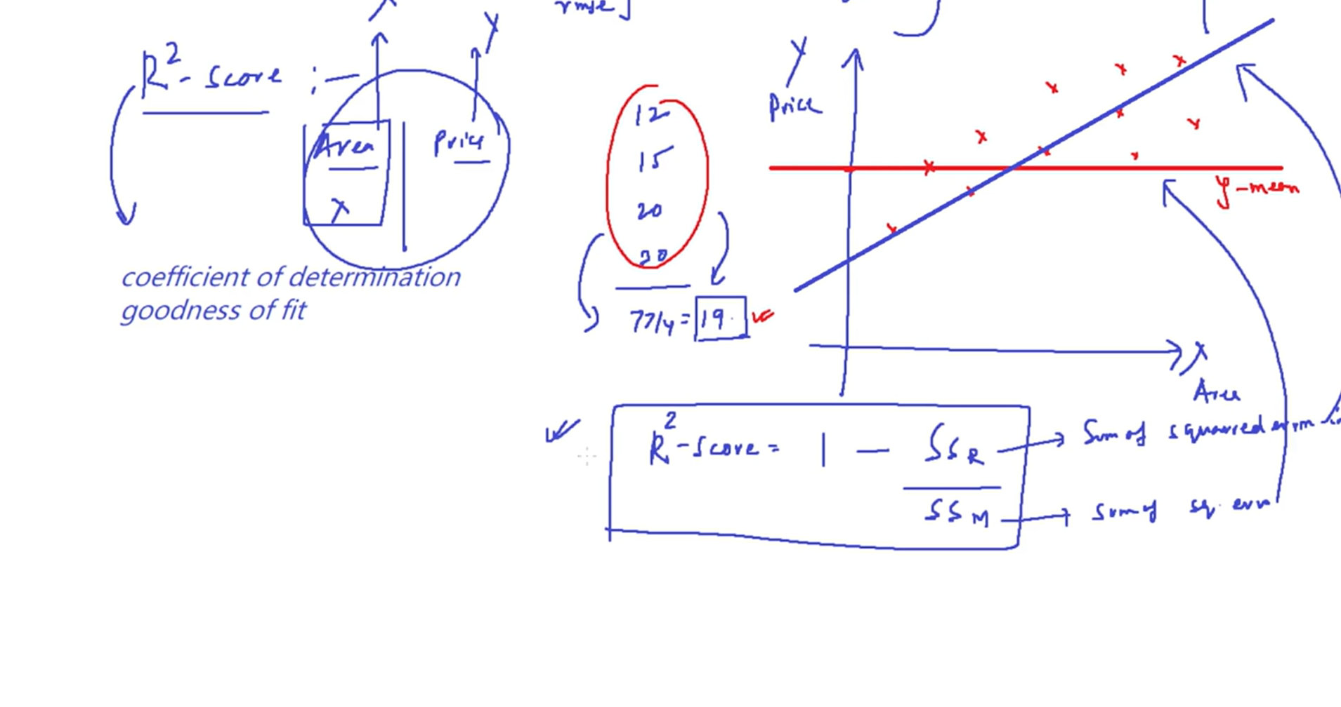

Slide 77
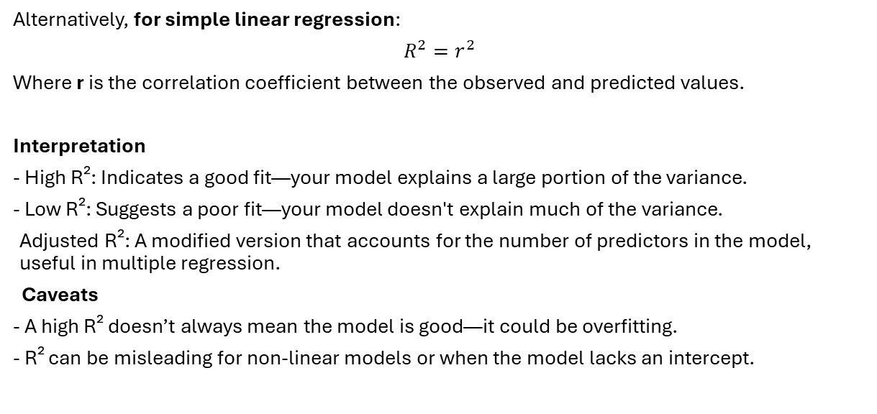
Alternatively, for simple linear regression:
$$R^{2}=r^{2}$$
Where r is the correlation coefficient between the observed and predicted values.
Interpretation
- High R²: Indicates a good fit—your model explains a large portion of the variance.
- Low R²: Suggests a poor fit—your model doesn't explain much of the variance.
Adjusted R²: A modified version that accounts for the number of predictors in the model, useful in multiple regression.
Caveats
- A high R² doesn’t always mean the model is good—it could be overfitting.
- R² can be misleading for non-linear models or when the model lacks an intercept.

Slide 78
Conditions for a Good Regression Line (in terms of R²)
To determine whether a regression line is a good fit for the data using the R² score,
here are the key conditions and interpretations: [ 0<=R^2<=1 (R^2 lies btw 0 to 1)]
R² Value | Interpretation | Condition Met?
R² ≈ 1 | Excellent fit: model explains nearly all variance | Ideal condition
R² ≥ 0.8 | Strong fit: model explains most variance | Generally acceptable
R² between 0.5–0.8 | Moderate fit: model explains some variance | May be acceptable depending on context
R² < 0.5 | Weak fit: model explains little variance | Poor condition
R² = 0 | No fit or bad : model explains nothing | Regression line is meaningless

Slide 79
Additional Considerations
Adjusted R²: Use this when dealing with multiple predictors to penalize unnecessary variables.
Context matters: In fields like economics or social sciences, even R² ≈ 0.3 might be acceptable due to high variability.
Visual inspection: Always complement R² with a residual plot or scatter plot to check for patterns or outliers.
---------------------------R² can be negative -----------------------
if your model performs worse than simply predicting the mean of the target variable. This usually happens when:
The model lacks an intercept
It's a poor fit for the data
You're evaluating on test data and it generalizes badly
A negative R² means your model is not just bad—it’s worse than doing nothing.

Slide 80
Adjusted R²
Adjusted R² (Adjusted R-squared) is a modified version of the regular R² that accounts for the number of predictors in your regression model.
In Short:
tells you how well your model fits the data.
Adjusted R² tells you how well your model fits after penalizing for extra predictors.
Why It Matters:
Adding more variables to a model always increases R², even if those variables are useless. Adjusted R² corrects for this by decreasing if the new predictors don’t improve the model meaningfully.

Slide 81
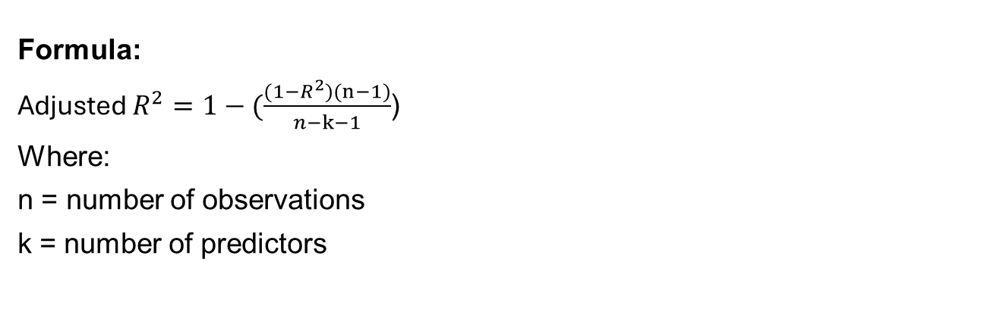
Formula:
Adjusted $R^{2}=1−(\frac{(1−R^{2})(n−1)}{n−k−1}$)
Where:
n = number of observations
k = number of predictors
Use Adjusted R² When:
You want to avoid overfitting
You’re comparing models with different numbers of predictors

Slide 82
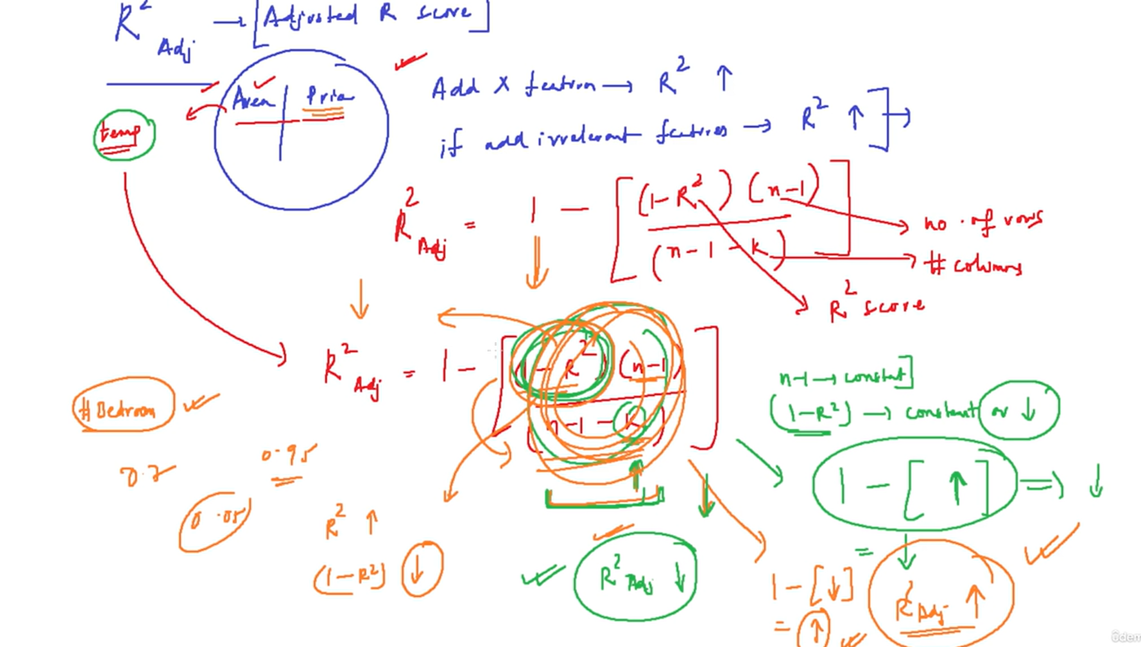

Slide 83
Classification Algorithms
35
Copyright © 2022 TalentLabs Limited
© zepanalytics.com

Slide 84

Classification
Predicting category of new observations
Let’s go through various classification algorithms:
1. k-nn ( K-nearest neighbours)
2. Decision Trees
3. Random Forest
4. Naive Bayes
5. Support Vector Machines
6. Logistic Regression
36
Copyright © 2022 TalentLabs Limited
© zepanalytics.com

Slide 85
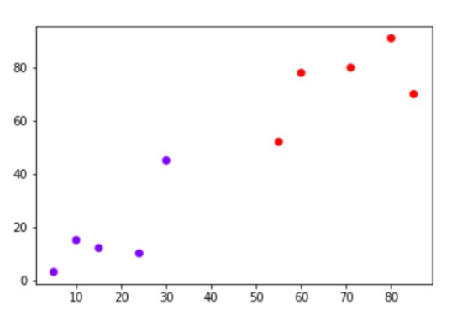
KNN (K-Nearest Neighbors)
Let say, we have a point at (40,60)
As we have 2 classes here, let’s assume k = 3 (k can be
any value as multiple of number of classes + 1)
As,wesee2redsand 1 bluenearbythe(40,60) mark, we
can assume the new datapoint as red class.
37
Copyright © 2022 TalentLabs Limited
© zepanalytics.com

Slide 86
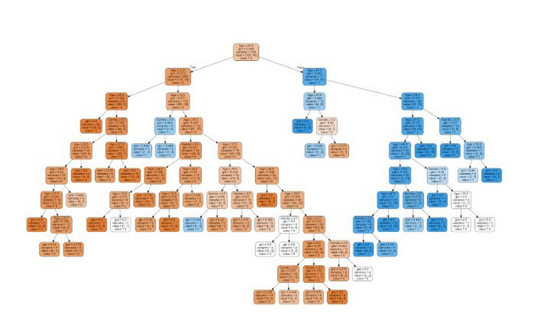
Decision Tree
It works on the principle of identifying the root node, and creates a tree to traverse from top- bottom approach to identify the right classes.
38
Copyright © 2022 TalentLabs Limited
© zepanalytics.com

Slide 87
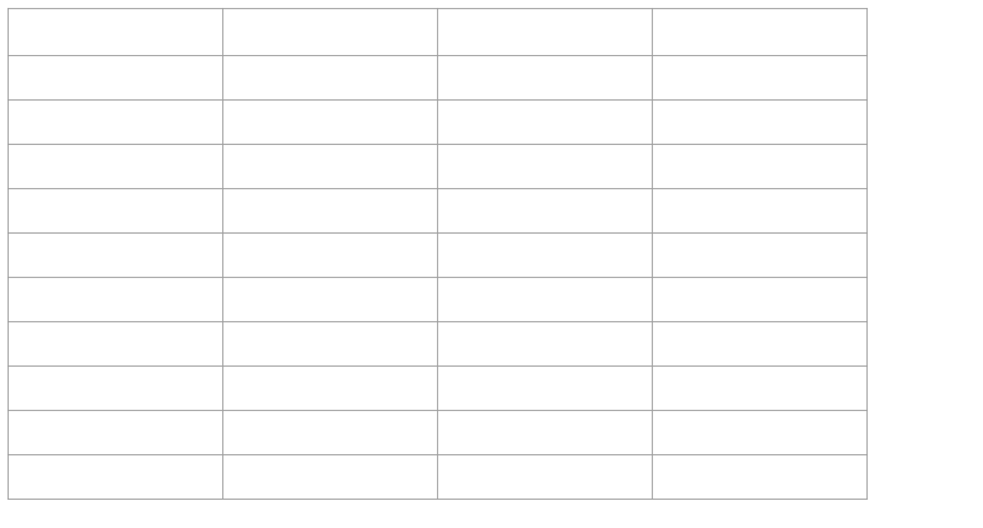
Decision Tree
Age
Old Old
Old
Mid Mid
Mid
Mid New New New
Competition
Yes No
No
Yes Yes
No
No Yes No No
Type
Software Software
Hardware
Software Hardware
Hardware
Software Software Hardware Software
Profit
Down Down
Down
Down Down
Up
Up Up Up Up
39
Copyright © 2022 TalentLabs Limited
© zepanalytics.com

Slide 88
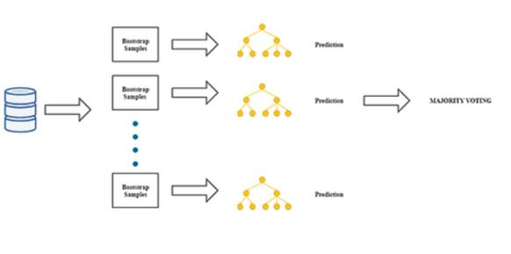
Random Forest
Random Forest uses multiple learning algorithms to obtain a better predictive performance. It uses decision trees as base learners.
40
Copyright © 2022 TalentLabs Limited
© zepanalytics.com

Slide 89
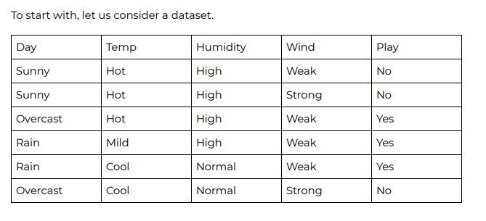
Naive Bayes
NaiveBayesclassifiers are a collection of classification algorithms based on Bayes’ Theorem. It is not a single
algorithm but a family of algorithms where all of them share a common principle, i.e. every pair of features being classified is independent of each other.
41
Copyright © 2022 TalentLabs Limited
© zepanalytics.com

Slide 90

Support Vector Machines
An SVM model is basically a representation of different classes in a hyperplane in multidimensional space. The hyperplane will be generated in an iterative manner by SVM so that the error can be minimized. The goal of SVM is to divide the datasets into classes to find a maximum marginal hyperplane (MMH).
42
Copyright © 2022 TalentLabs Limited
© zepanalytics.com

Slide 91

Logistic Regression
Logistic Regression is a supervised Machine Learning algorithm and despite the word ‘Regression’, it is used in binary classification. By binary classification, it meant that it can only categorize data as 1 (yes/success) or a 0 (no/failure). In other words, we can say that the Logistic Regression model predicts P(Y=1) as a function of X.
43
Copyright © 2022 TalentLabs Limited
© zepanalytics.com

Slide 92

Classification Metrics -Log Loss
Cost = -(yact)ln (ypred) -(1-yact)ln(1-ypred)
Cost = -ln ypred, where yact = 1
Cost = -ln (1-ypred), where yact = 0
44
Copyright © 2022 TalentLabs Limited
© zepanalytics.com

Slide 93

Confusion Matrix
Usefulformeasuringrecall,precision, specificity, accuracy &
AUC-ROC Curve.
False Positive: Type I Error False Negative: Type II Error
45
Copyright © 2022 TalentLabs Limited
© zepanalytics.com

Slide 94

Confusion Matrix
y
ypred
output for threshold 0.6
0
1
1
1
0 0 0
TP
TN
FP
FN
Recall
Precisio n
Accurac y
0
1
0
1
1 0 1
0.5
0.9
0.7
0.7
0.3 0.4 0.5
2
2
1
2
1/2
2/3
4/7
46
Copyright © 2022 TalentLabs Limited
© zepanalytics.com

Slide 95




Classification Metrics -Area under ROC
47
Copyright © 2022 TalentLabs Limited
© zepanalytics.com

Slide 96

Issues in Classification
There are many issues that occur while you solve a
Classificationproblem,such as
1.
2.
Overfitting
Class Imbalance Problems
48
Copyright © 2022 TalentLabs Limited
© zepanalytics.com

Slide 97
Clustering Algorithms
49
Copyright © 2022 TalentLabs Limited
© zepanalytics.com

Slide 98

Clustering
Clustering methods are a Machine Learning technique that involves the grouping of data points. These methods are used to ﬁnd similarity as well as the relationship patterns among data samples and then cluster those samples into groups having similarity based on features. Types of Clustering Algorithms: 1. K-Means Clustering 2. Hierarchical Clustering 3. Mean-Shift Algorithm
50
Copyright © 2022 TalentLabs Limited
© zepanalytics.com

Slide 99

K-means Clustering
Pseudo Code:
1.
2. 3. 4.
5.
6.
Choose number of K Clusters
Select a random K points, the centroids (not
necessarily from the dataset)
Assign each data set point to the nearest
→That forms K clusters
Compute & place new centroid for eachcluster
centroid
Reassign each data point to the closest
centroid.
If any reassignment took place, go to Step4,else
FINISH.
51
Copyright © 2022 TalentLabs Limited
© zepanalytics.com

Slide 100








Hierarchical Clustering
Fish
Poodle Pug
…
Dogs
Cats
…
Mammals
Animal
…
Birds
Penguin
Emu
Kiwi
…
Flying
Flightless
52
Copyright © 2022 TalentLabs Limited
© zepanalytics.com

Slide 101

Hierarchical Clustering
Pseudo Code:
1. 2. 3. 4.
Make each data point a single point cluster →N Clusters Take two closest data points & make 1 cluster →N -1 Clusters Take two closest clusters & make 1 →N -2 Clusters Repeat Step 3 until there is one cluster.
Pros:
HC shows all the possible linkages between clusters, & we understand the data better. Cons: Can’t handle big data
53
Copyright © 2022 TalentLabs Limited
© zepanalytics.com

Slide 102

Mean Shift Clustering
Mean-shift algorithm basically assigns the data points to the clusters iteratively by shifting points towards the highest density of data points i.e. cluster centroid.
The difference between K-Means algorithm and
Mean-Shift is that later one does not need to specify
the number of clusters in advance because the
number of
the algorithm w.r.t. data.
clusters will be determined by
54
Copyright © 2022 TalentLabs Limited
© zepanalytics.com

Slide 103
Association Rule Learning
55
Copyright © 2022 TalentLabs Limited
© zepanalytics.com

Slide 104

Association Rule Learning
From Wikipedia:
Association rule learning is a rule-based machine learning method for discovering interesting relations between variables in large databases. It is intended to identify strong rules discovered databases using some measures of interest.
56
Copyright © 2022 TalentLabs Limited
© zepanalytics.com

Slide 105

Association Rule Learning -Apriori
Support:
This explains how important an itemset is, as measured by the proportion of transactions in which an itemset appears. Support(Apple) = 4/8
Lift: This says how likely item Y is purchased when item X is purchased, while controlling for how popular item Y is. Lift(Apple→Beer) = Support(Apple,Beer)/(Support(Apple)*Support(Beer))
= (⅜) / (4/8*6/8) = ⅜
* 64/24 = 1
Confidence:
This says how likely item Y is purchased when item X is
purchased, expressed as [X→Y]
Confidence(Apple→Beer) =
Support(Apple,Beer)/Support(Apple)
=(
)/(4/8) =
*2=¾
⅜
⅜
57
Copyright © 2022 TalentLabs Limited
© zepanalytics.com

Slide 106


Association Rule Learning -Eclat
ECLAT:
EquivalenceClassClustering and bottom-up Lattice Traversal
How the algorithm work?
•
The basic idea is to use Transaction Id Sets(tidsets) intersections to compute the support value of a candidate and avoiding the generation of subsets which do not exist in the preﬁx tree. Uses breadth first search and hence does not use a lot of memory Computationally Faster than apriori In Apriori we need to add Support, Confidence But in Eclat only we need to give Support.
• •
•
58
Copyright © 2022 TalentLabs Limited
© zepanalytics.com

Slide 107



Association Rule Learning -Eclat
59
Copyright © 2022 TalentLabs Limited
© zepanalytics.com

Slide 108






Association Rule Learning -Eclat
60
Copyright © 2022 TalentLabs Limited
© zepanalytics.com

Slide 109
Ensemble Techniques
61
Copyright © 2022 TalentLabs Limited
© zepanalytics.com

Slide 110

Ensemble Techniques
Ensemble Learning is the mechanism to use multiple algorithms together to have a better prediction than the individual models.
Let say, we extract the features from a use case, and try
check the model’s accuracy or behaviour individually.
Features →Decision Trees →69%
Features →SVM →75%
Features →Logistic Regression →65%
to
So why use Ensemble Learning?
1. Better Accuracy (Low Error)
2. Higher Consistency (Avoids Overﬁtting)
3. Reduces Bias & Variance Errors
62
Copyright © 2022 TalentLabs Limited
© zepanalytics.com

Slide 111

Ensemble Techniques -Cont.
When and Where do we use Ensemble Learning? 1. Single model overﬁts 2. Results worth the extra training 3. Can be used for classiﬁcation & regression both.
Popular Ensemble Methods
1. Bootstrap Aggregation (Bagging)
Bagging Algorithms:
a. Bagged Decision Trees
b. Random Forest
c. Extra Trees
63
Copyright © 2022 TalentLabs Limited
© zepanalytics.com

Slide 112

Ensemble Techniques -Cont.
2. Boosting
Boosting is used to create a collection of predictors. In
this technique, learners are learned sequentially with early
learners ﬁtting simple models to the data and then
analysing data for errors. Consecutive trees (random
sample) are ﬁt and at every step, the goal is to
improve the accuracy from the prior tree. When an
input is misclassiﬁed by a hypothesis, its weight is
increased so that the next hypothesis is more likely to
classify it correctly. This process converts weak learners
into better performing model.
64
Copyright © 2022 TalentLabs Limited
© zepanalytics.com

Slide 113

Ensemble Techniques -Cont.
Bagging:
1.
2.
Bagged Decision Trees
All features are used for splitting a node.
Random Forest
Subset of features are used at random out of the total
and the best split feature from the subset is used to
split each node in a tree,
Extra Trees
3.
Boosting
1.
2.
AdaBoost
Stochastic Gradient Boosting
65
Copyright © 2022 TalentLabs Limited
© zepanalytics.com

Slide 114
Time Series Analysis
66
Copyright © 2022 TalentLabs Limited
© zepanalytics.com

Slide 115

Time Series Analysis
•
Time series forecasting is an important area of machine learning that is often neglected. It is important because there are so many prediction problems that involve a time component and these problems are often neglected because it is this time component that makes time series problems more difficult to handle. Before getting started with Time Series Analysis, let’s get our basics clear on Anomaly Detection
•
•
67
Copyright © 2022 TalentLabs Limited
© zepanalytics.com

Slide 116

What is Time Series?
It is a series of observations taken at specified times basically at equal intervals. It is used to predict future values based on past observed values.
68
Copyright © 2022 TalentLabs Limited
© zepanalytics.com

Slide 117




Components of Time Series
STreeansdonality
CIrryecgliuclarity
Trend
Seasonality
Irregularity
Cyclic
Increasing or
Decreasingvalue in
the series
A general systematic linear or (most often) non-linear component that changes over time and does repeat.
The data in the time series follows a temporal sequence, but the measurements might not happen at a regular time interval.
Pattern exists when data exhibit rises & falls that are not of
fixed period.
© zepanalytics.com

Slide 118

Testing TS Stationarity
Company
Checks for Stationarity
There are many methods tocheckwhetheratimeseriesisstationary or non-stationary.
1.
2. 3.
Look at Plots: You can review a time series plot of your data and visually check if there are any
obvious trends or seasonality.
Summary Statistics: You can review the summary statistics for your data for seasons or random
partitions and check for obvious or significant differences.
Statistical Tests: You can use statistical tests to check if the expectations of stationarity are met
or have been violated.
You can split your time series into two (or more) partitions and compare the mean and variance of
each group. If they differ and the difference is statistically significant, the time series is likely non-
stationary.
© zepanalytics.com

Slide 119
Testing TS Stationarity
Company
Checks for Stationarity
Statistical tests make strongassumptions about your data.They can only be used to inform the degree
to which a null hypothesis can be rejected or fail to be reject. The result must be interpreted for a given problem to be meaningful.
Nevertheless, they can provide a quick check and confirmatory evidence that your time series is
stationary or non-stationary.
ADF Test is otherwise known as unit root test.
© zepanalytics.com

Slide 120
Testing TS Stationarity
Company
Checks for Stationarity
The null hypothesis of the test is thatthe timeseries canberepresented byaunit root, that it is not stationary (has some
time-dependent structure). The alternate hypothesis (rejecting the null hypothesis) is that the time series is stationary.
Null Hypothesis (H0): If failed to be rejected, it suggests the time series has a unit root, meaning it is non-stationary. It
has some time dependent structure.
Alternate Hypothesis (H1): The null hypothesis is rejected; it suggests the time series does not have a unit root,
meaning it is stationary. It does not have time-dependent structure.
●
●
Weinterpretthisresultusingthep-valuefromthetest.Ap-valuebelowathreshold(suchas5%or1%)suggestswereject the
null hypothesis (stationary), otherwise a p-value above the threshold suggests we fail to reject the null hypothesis (non- stationary).
p-value > 0.05: Fail to reject the null hypothesis (H0), the data has a unit root and is non-stationary.
p-value <= 0.05: Reject the null hypothesis (H0), the data does not have a unit root and is stationary.
●
●
© zepanalytics.com

Slide 121

Company
Checks for Stationarity
ARIMA (AR, MA, ARMA, ARIMA) Facebook Prophet LSTMs Holt’s Winter Exponential Smoothing GARCH SARIMA/SARIMAX VAR VARMA etc. etc.
Algorithms
Quick Link: https://machinelearningmastery.com/time-series-
forecasting-methods-in-python-cheat-sheet/
© zepanalytics.com

Slide 122
ARIMA
MARA
AR
MA
ARMA
ARIMA
RIMAA
Auto regressive
Moving Average
Autoregressive
IntegratedMoving
Average
Autoregressive Moving Average (No differencing)
© zepanalytics.com

Slide 123
ARIMA
Checks for Stationarity
Company
Therearedifferent techniques tofindtherightparametersforARIMA(p,d,q)
• • •
ACF/PACF Plots Grid Search Auto Arima
Let’s learn about these techniques in the next slides.
© zepanalytics.com

Slide 124



Auto Correlation
Partial Auto Correlation
Company
Checks for Stationarity
1. 2.
PACF
chart crosses the upper confidence interval for the first time. If you notice
p–The lag value where the closely, in this case p=2. q–The lag value where the
ACF
chart crosses the upper confidence interval for the first time. If you notice
closely, in this case q=2.
© zepanalytics.com

Slide 125
ACF/PACF plots are some traditional methods of
Company
Checks for Stationarity
obtaining p & q values, and are sometimes misleading, hence we need to perform a hyper parameter optimization step in Time Series Analysis to get the optimum p,d& q values
Grid Search
© zepanalytics.com

Slide 126
Company
Checks for Stationarity
Grid Search techniques are manual ways, the same task can be achieved in few lines of coding and with a better efficiency using Auto Arima
Auto Arima
© zepanalytics.com

Slide 127

Quick Link:
Company
Checks for Statiohntatrpitsy://facebook.github.io/prophet/do
cs/quick_start.html#python-api
Features:
Facebook Prophet
• •
Very fast An additive regression model where non- linear trends are fit with yearly, weekly, and daily seasonality, plus holiday effects Robust to missing data & shifts in trend, and handles outliers automatically. Easy procedure to tweak & adjust forecast while adding domain knowledge or business insights.
• •
© zepanalytics.com

Slide 128


Quick Link:
Company
Checks for Statiohntatrpitsy://colah.github.io/posts/2015-08-
Understanding-LSTMs/
Features:
LSTM cell in place of standard neural
network layers:
LSTMs
Input gate
Forget gate
Output gate
1.
2.
3.
© zepanalytics.com

Slide 129
Dimensionality Reduction - Feature Engineering
81
Copyright © 2022 TalentLabs Limited
© zepanalytics.com

Slide 130


Dimensionality Reduction
Two Techniques:
1.
Feature Selection
a.
Wrappermethods
i. ii.
Recursive feature elimination Successive feature selection
b.
Filtering methods: IG, Chi Square, Correlation Coefficient Embedded methods: Decision Trees
c.
2.
Feature Extraction
a.
Principal Component Analysis
b. c. d.
Linear Discriminant Analysis Quadrant Discriminant Analysis Kernel PCA
82
Copyright © 2022 TalentLabs Limited
© zepanalytics.com

Slide 131


Dimensionality Reduction
PrincipalComponentAnalysis
•
Principal Component Analysis (PCA) is basically a dimensionality reduction algorithm, but it can also be useful as a tool for visualization, noise filtering, feature extraction & engineering, and much more.
PCA creates a visualization of data that
minimizes residual variance in the least squares
sense and maximizes the variance of the
projection coordinates
•
83
Copyright © 2022 TalentLabs Limited
© zepanalytics.com

Slide 132



Dimensionality Reduction
Linear Discriminant Analysis
•
LDAislikePCAbutitfocuses on maximizing
separatibilityamongknown categories
• •
LDAisasupervised algorithm
Maximisingdistancebetween classes and
minimising spread/scatter within each category.
•
LDAhassubstantiallylower variance. This can
potentiallyleadtoimproved prediction
performance.
84
Copyright © 2022 TalentLabs Limited
© zepanalytics.com

Slide 133


Dimensionality Reduction
Quadratic Discriminant Analysis
•
QDA (Quadratic Discriminant Analysis) is used to find a non-linear boundary between classifiers.
The more the classes are separable and the
more the distribution is normal, the better will be
the classification result for LDA and QDA.
•
85
Copyright © 2022 TalentLabs Limited
© zepanalytics.com

Slide 134
Hyperparameter Optimization
86
Copyright © 2022 TalentLabs Limited
© zepanalytics.com

Slide 135
Hyper Parameter Optimization
Machine Learning models are composed of two different types of parameters: -Hyperparameters= are all the parameters which can be arbitrarily set by the user before starting training (eg. number of estimators in Random Forest). -Model parameters =are instead learned during the model training (eg. weights in Neural Networks, Linear Regression).
The model parameters define how to use input data to get the desired output and are learned at training time. Instead, Hyperparameters determine how our model is structured in the first place.
87
Copyright © 2022 TalentLabs Limited
© zepanalytics.com

Slide 136


Hyper Parameter Optimization
Machine Learning models tuning is a type of optimization problem. We have a set of hyperparameters and we aim to find the right combination of their values which can help us to find either the minimum (eg. loss) or the maximum (eg. accuracy) of a function This can be particularly important when comparing how different Machine Learning models performs on a dataset. In fact, it would be unfair for example to compare an SVM model with the best Hyperparameters against a Random Forest model which has not been optimized.
88
Copyright © 2022 TalentLabs Limited
© zepanalytics.com

Slide 137

Hyper Parameter Optimization
The aim of hyperparameter optimization in machine learning is to find the hyperparameters of a given machine learning algorithm that return the best performance as measured on a validation set. f(x) -an objective score to minimize—such as RMSE or error rate—evaluated on the validation set; x* -is the set of hyperparameters that yields the lowest value of the score x -can take on any value in the domain X.
In simple terms, we want to find the model hyperparameters that yield the best score on the validation set metric.
89
Copyright © 2022 TalentLabs Limited
© zepanalytics.com

Slide 138

Hyper Parameter Optimization
Following are four common methods of hyperparameter optimization formachine learning in order of increasing efficiency:
-Grid search
- Manual
-Random search
-Bayesian model-based optimization
.
90
Copyright © 2022 TalentLabs Limited
© zepanalytics.com

Slide 139
Hyper Parameter Optimization
Each time we try different hyperparameters, we have to train a model on the training data, make predictions on the validation data, and then calculate the validation metric. With a large number of hyperparameters and complex models such as ensembles or deep neural networks that can take days to train, this process quickly becomes intractable to do by hand!Grid search and random search are slightly better than manual tuning because we set up a grid of model hyperparameters and run the train-predict -evaluate cycle automatically in a loop while we do more productive things .
Grid and random search are completely uninformed by past evaluations, and as a result, often spend a
significant amount of time evaluating “bad” hyperparameters.
91
Copyright © 2022 TalentLabs Limited
© zepanalytics.com

Slide 140
Hyper Parameter Optimization
For example, if we have the following graph with a lower score being better, where does it make sense to concentrate our search? If you said below 200 estimators, then you already have the idea of Bayesian optimization! We want to focus on the most promising hyperparameters, and if we have a record of evaluations, then it makes sense to use this information for our next choice
Random and grid search pay no attention to past results at
alland wouldkeep searchingacross theentire rangeof the number of estimators even though it’s clear the optimal answer (probably) lies in a small region!
92
Copyright © 2022 TalentLabs Limited
© zepanalytics.com

Slide 141
Random Forest Hyper Parameter
max_depth →Longest path between root node and leaf node
n_estimators consider
Number of trees should we
→
min_sample_split →parameter that tells the
decision tree in a random forest the minimum
required no. of observations in any given node in
order to split it. Default value is 2.
max_samples
→
whatfractionoforiginaldataset is
given to any individual tree. (Bootstrap sample fraction)
max_terminal_nodes →Condition on the splitting
the nodes in tree, and restricts growth of tree
max_features
→
How many features to use in each
tree in a RF.
93
Copyright © 2022 TalentLabs Limited
© zepanalytics.com

Slide 142

Thank you
9 4
Copyright © 2022 TalentLabs Limited
© zepanalytics.com

